Slide 1
Semantic Keyword-based Search on Geospatial Data Sources
3rd KEYSTONE Training School, TU Wien, Austria. 21-25 August 2017
José R.R. Viqueira
Notes:
10 minutes

Slide 2
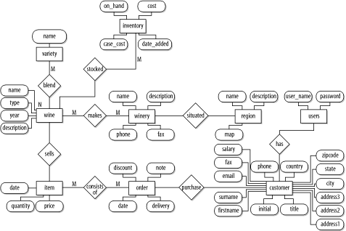

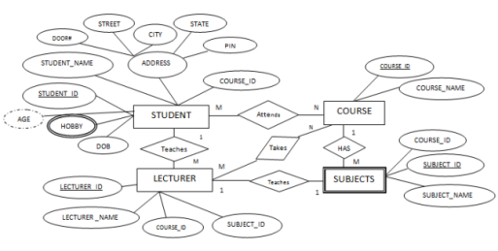
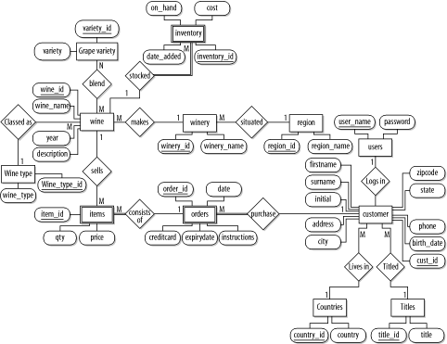
Introduction
Much of the data managed by any organization has a geographic component
60% - 80%
?

Slide 3
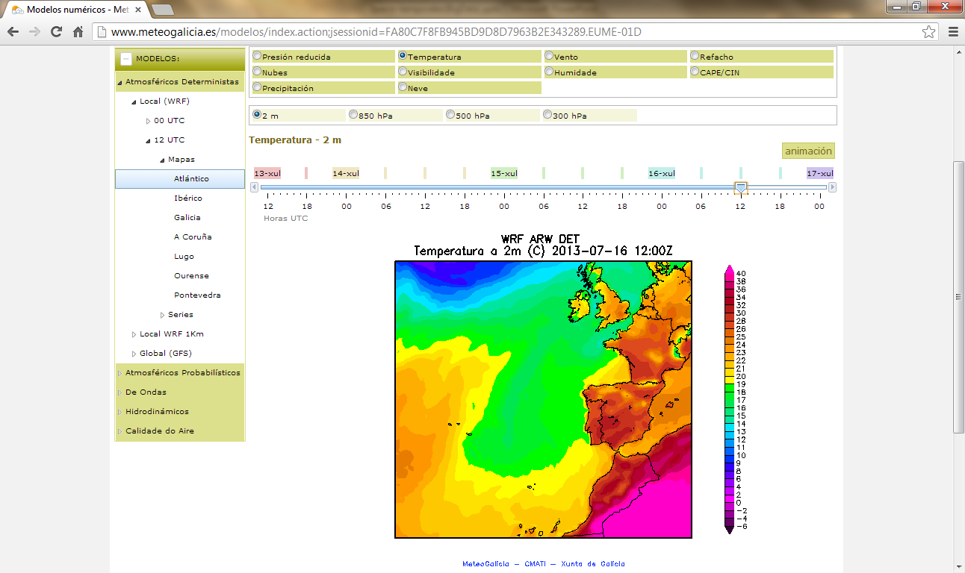
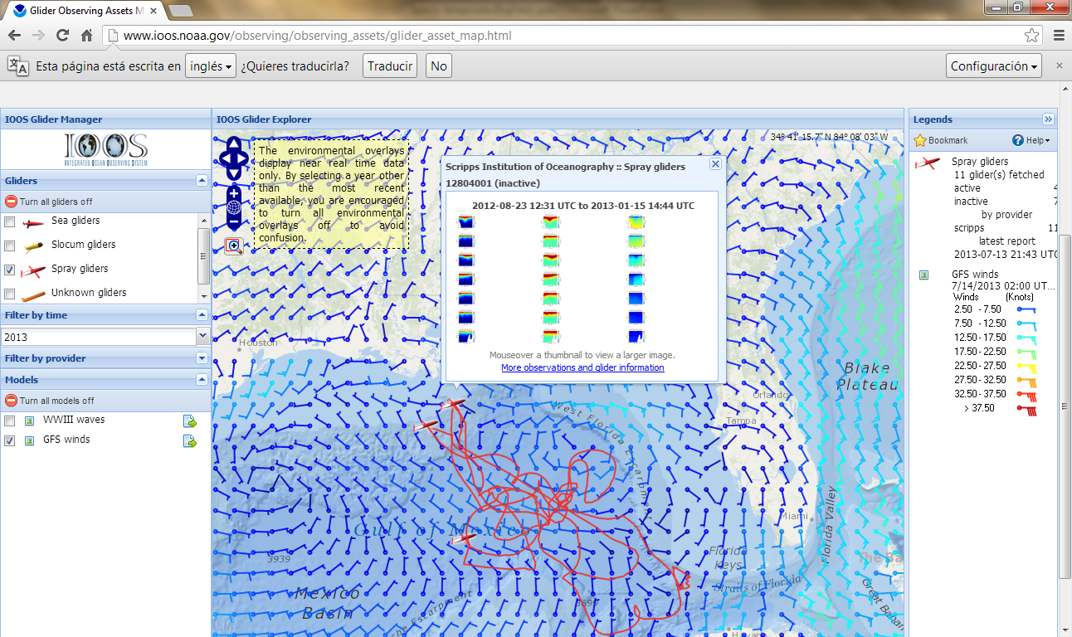
Introduction
Traditional Applications (1/4)
Environmental Monitoring and Modeling
http://www.meteogalicia.gal
https://ioos.noaa.gov

Slide 4
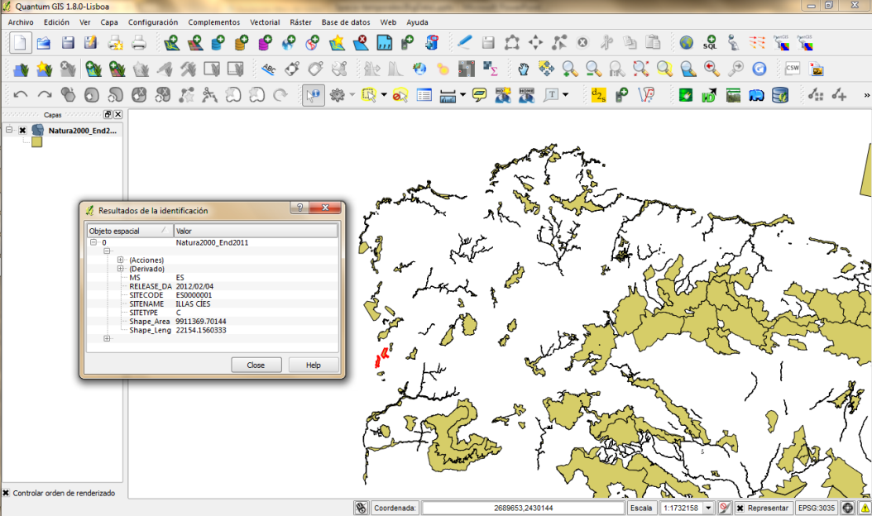
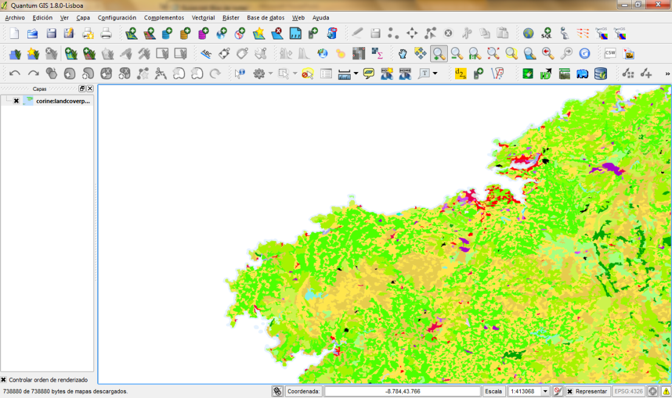
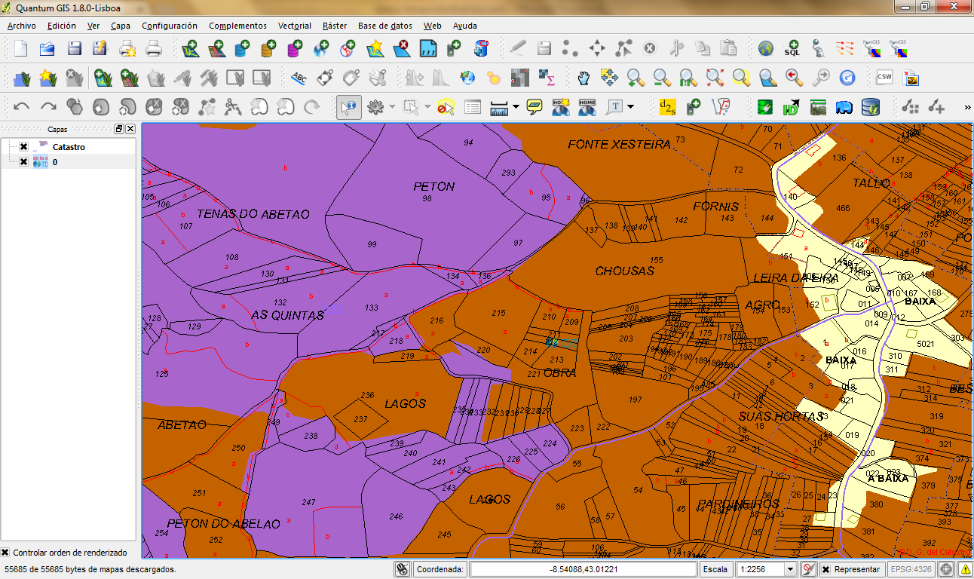
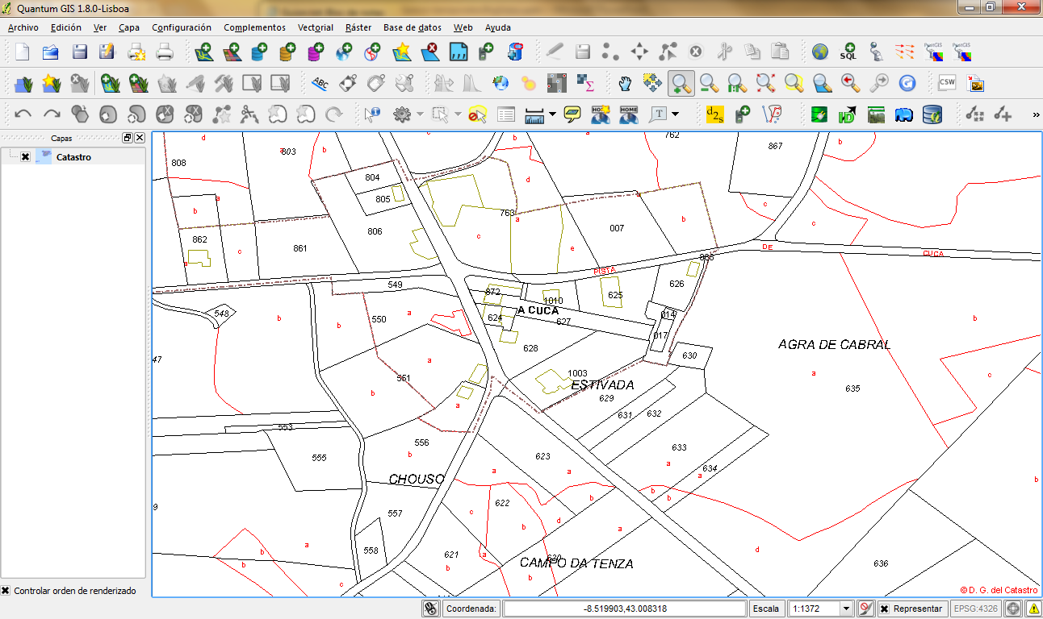
Introduction
Traditional Applications (2/4)
Land Management

Slide 5
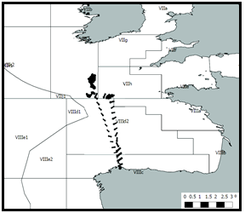
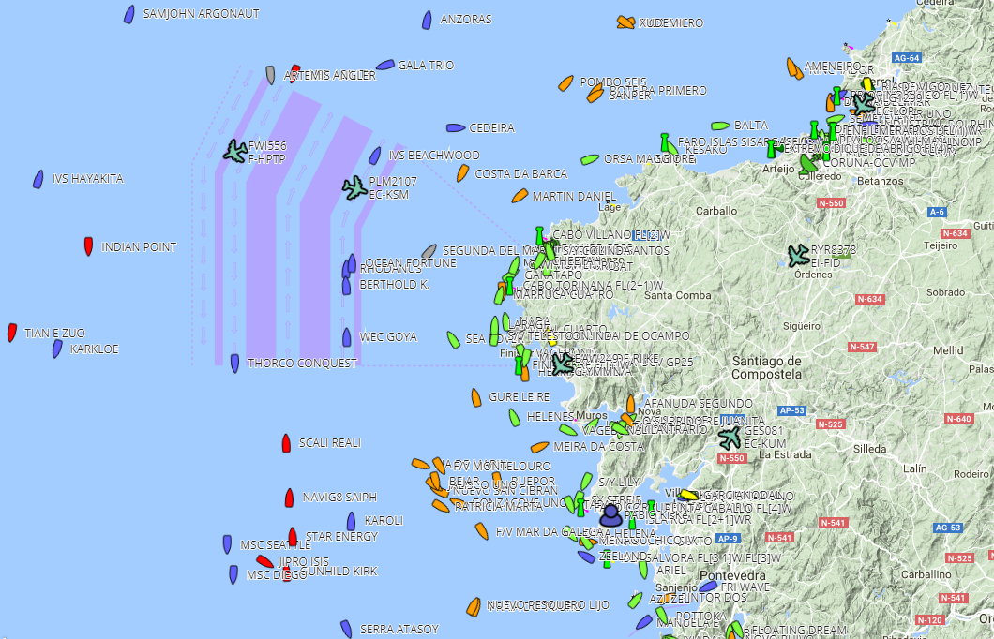
Introduction
Traditional Applications (3/4)
Fleet Management
http://www.localizatodo.com/

Slide 6
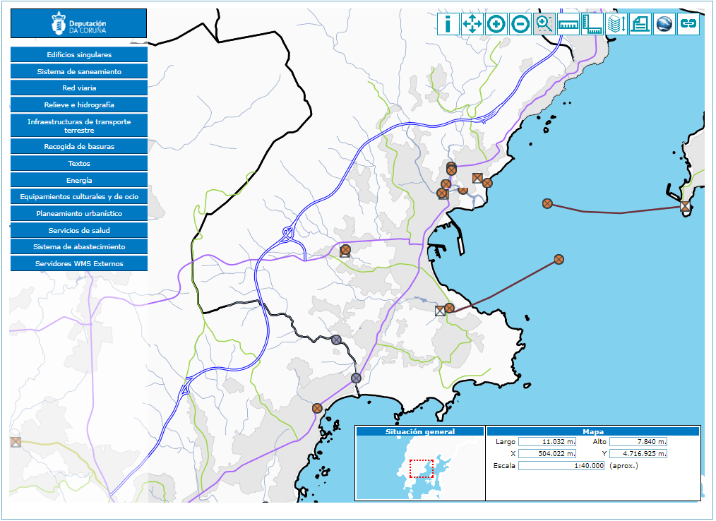
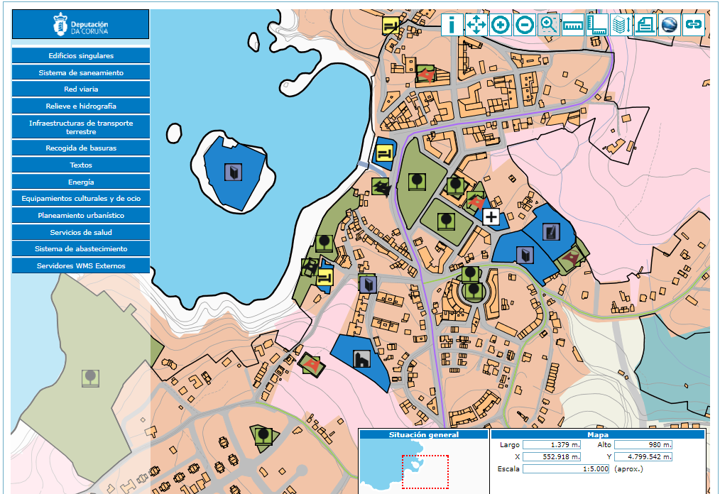
Introduction
Traditional Applications (4/4)
Infrastructure Management
https://webeiel.dicoruna.es

Slide 7


Introduction
New Applications (1/3)
Mobile Devices

Slide 8
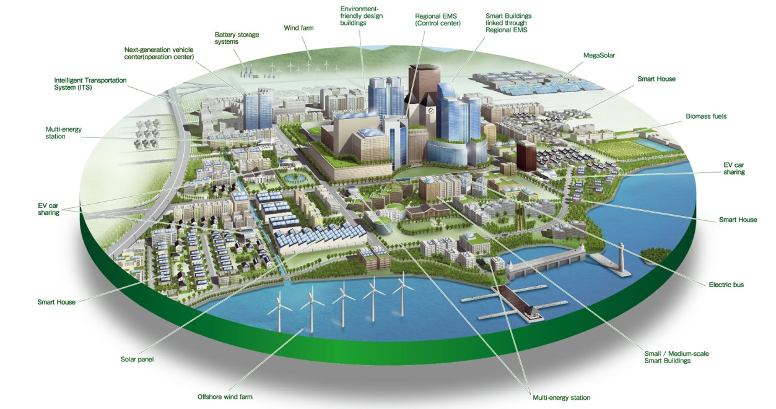
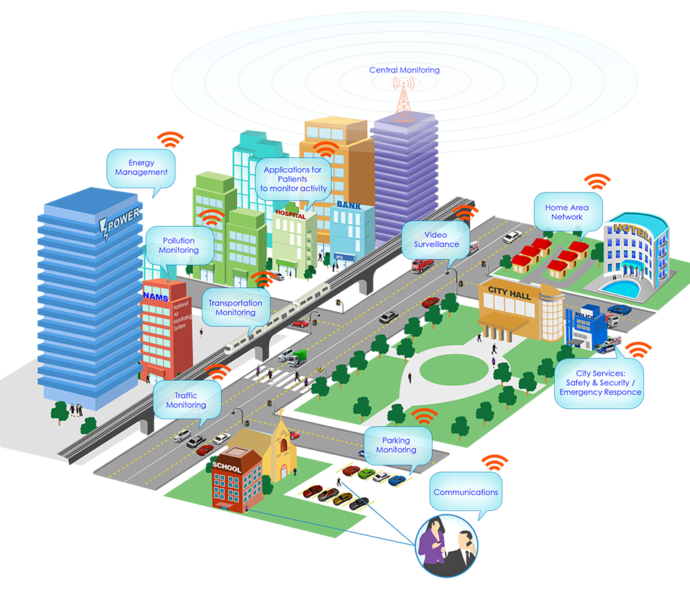
Introduction
New Applications (2/3)
Smart Cities
https://www.structuralia.com
http://www.eoi.es

Slide 9
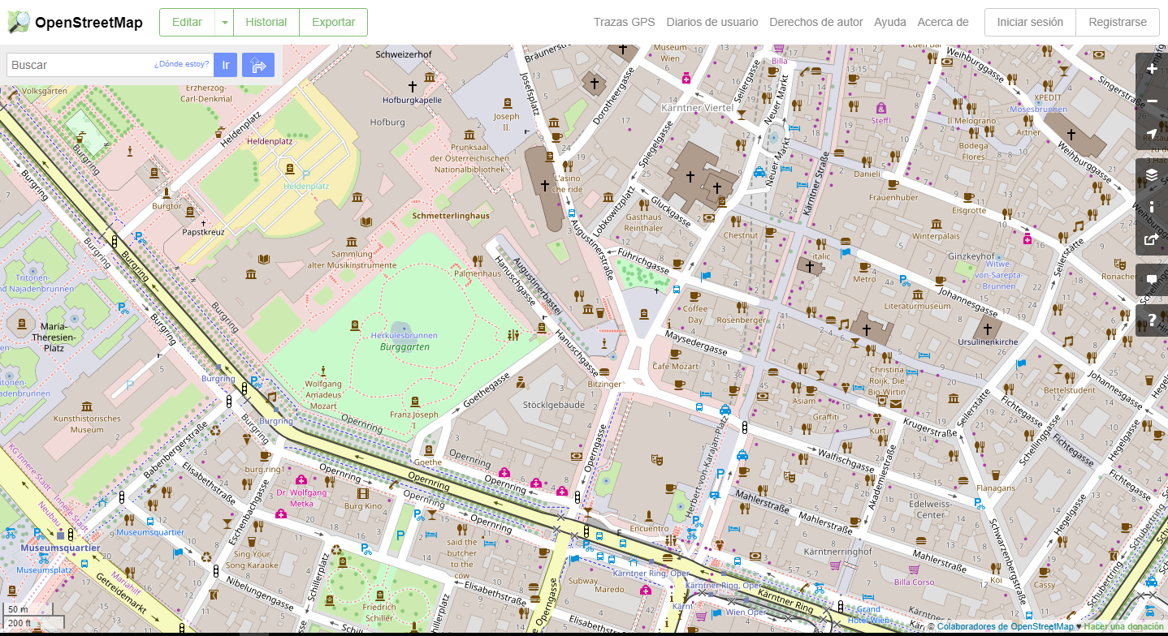
Introduction
New Applications (3/3)
Volunteered geographic information

Slide 10
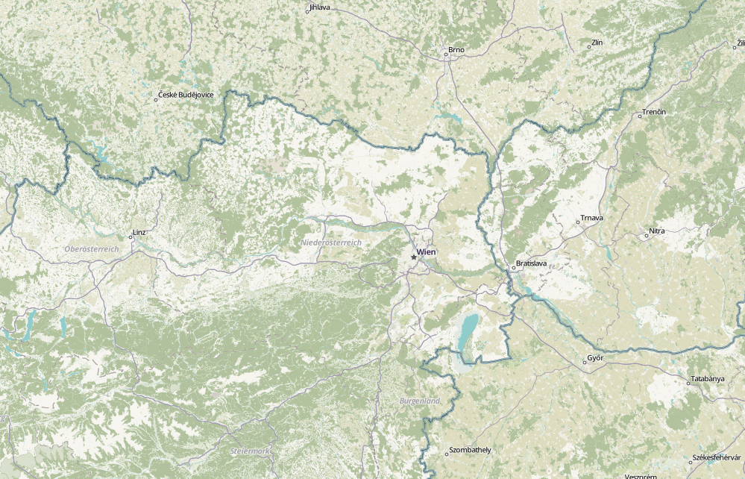
Introduction
Geographic Data Sources (1/3)
Structured: defined by authorities
Adm. Divisions
Transportation networks
Points of interest
Etc.

Slide 11
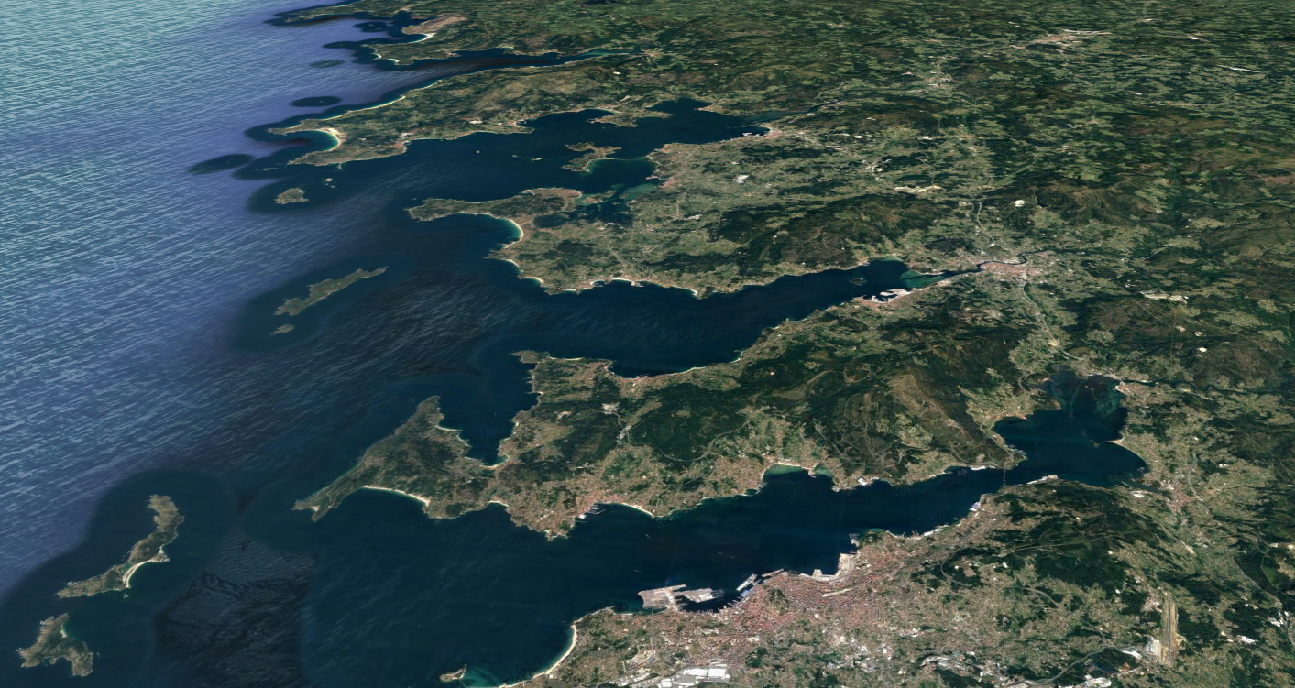





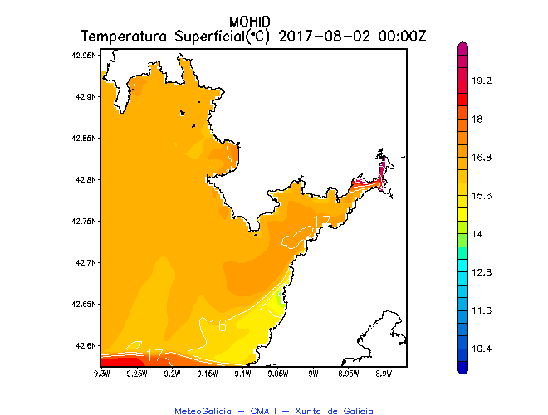
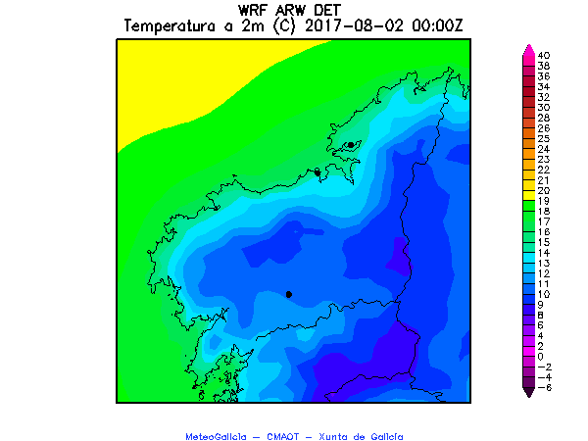
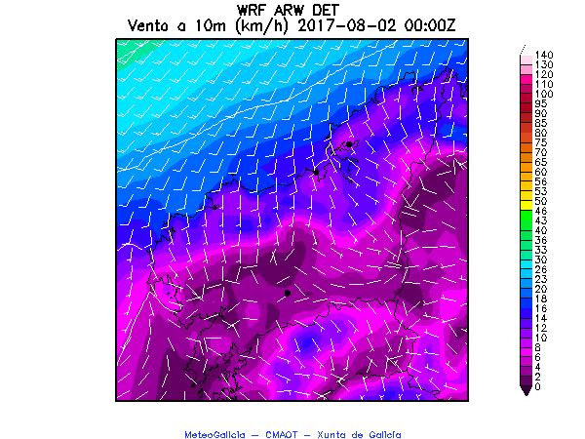
Introduction
Geographic Data Sources (2/3)
Structured: Observed or Modelled by Processes
Meteorological
Oceanographic
Pollution
Elevation
Etc.
Ocean.
Station
CTD Sampling
Radar
Radiosounding
Ocean.
Station
Meteo.
Stations

Slide 12
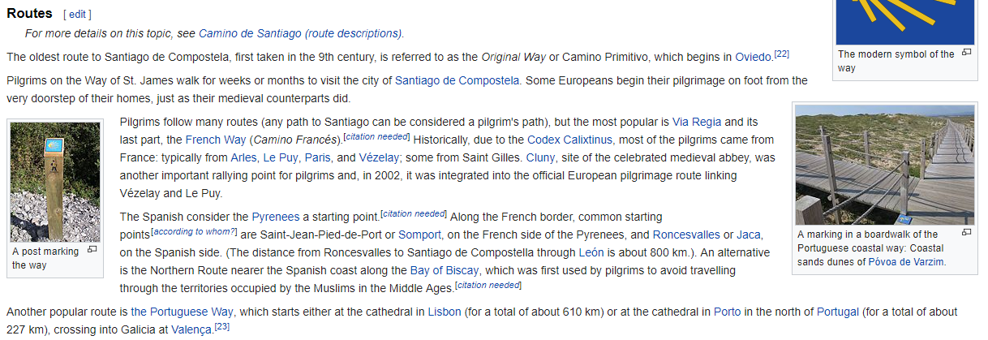
Introduction
Geographic Data Sources (3/3)
Unstructured: Referenced Geographic Features

Slide 13
Introduction
What is Special? (1/2)
Complex 2D and/or 3D Structures
1D Real
B+-tree
1D Real
B+-tree
Hotel
Id | Name | Beds | x | y
Municipality
Id | Name | Population
Mun_Coords
MunId | x | y
Hotel (X, Y)
2D Polygon
R-tree
2D Point
R-tree
Hotel
Id | Name | Beds | Point
Municipality
Id | Name | Population | Polygon
Municipality (X, Y)

Slide 14
Introduction
What is Special? (2/2)
Complex Implicit Spatial Relationships
Obtain the names of the hotels inside the municipality of Trazo
=, <>, >, <, >=, <=
Hotel
Id | Name | Beds | x | y
Municipality
Id | Name | Population
Mun_Coords
MunId | x | y
Hotel (X, Y)
Hotel
Id | Name | Beds | Point
Municipality
Id | Name | Population | Polygon
Municipality (X, Y)
Within

Slide 15
Outline
Overview of Geospatial Data Management
Geospatial Information Retrieval
Geospatial Semantic Web
Examples of ongoing work

Slide 16
Overview of Geospatial Data Management
3rd KEYSTONE Training School, TU Wien, Austria. 21-25 August 2017
José R.R. Viqueira
Notes:
30 minutes

Slide 17
Overview of Geospatial Data Management
Contents
Geospatial Data Modeling
Geospatial Data Structures and Algorithms
Geospatial Data Management Technologies
Geospatial Data Infrastructures
Bibliography

Slide 18
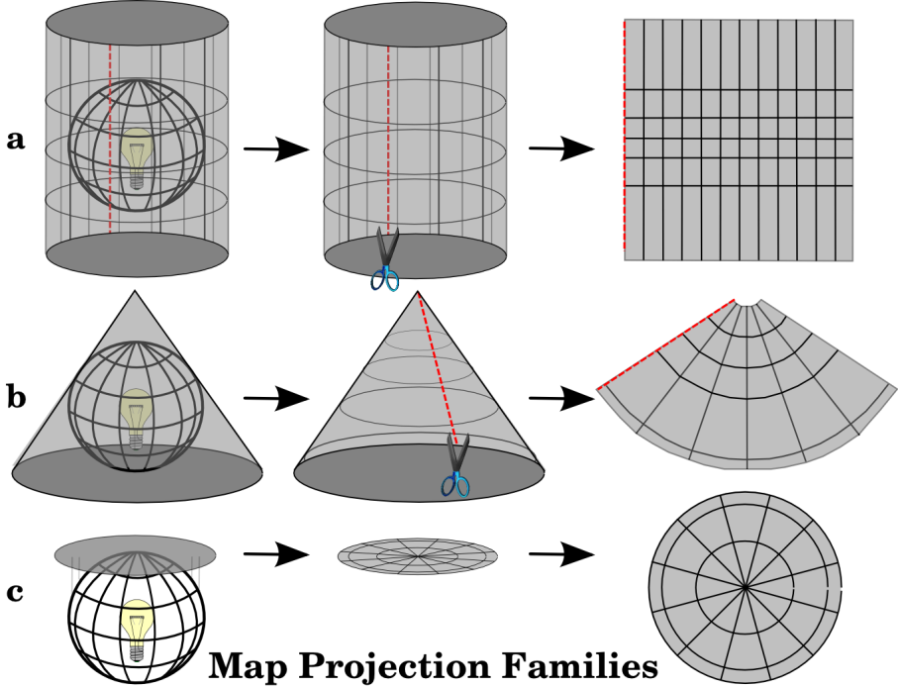
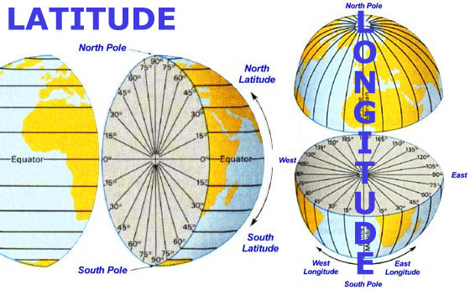
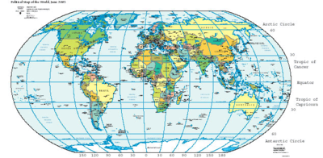
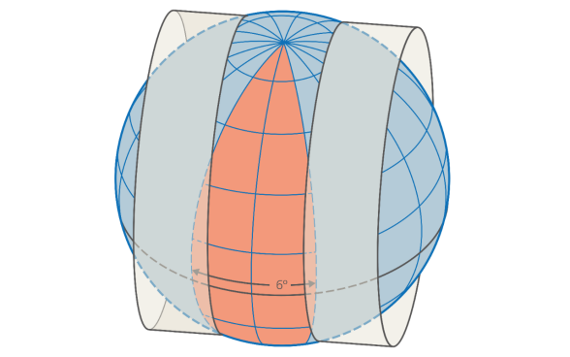
Overview of Geospatial Data Management
Geospatial Data Modeling (1/3)
ISO 19111
Geographic Space
Universal Traverse
Mercator (UTM)

Slide 19
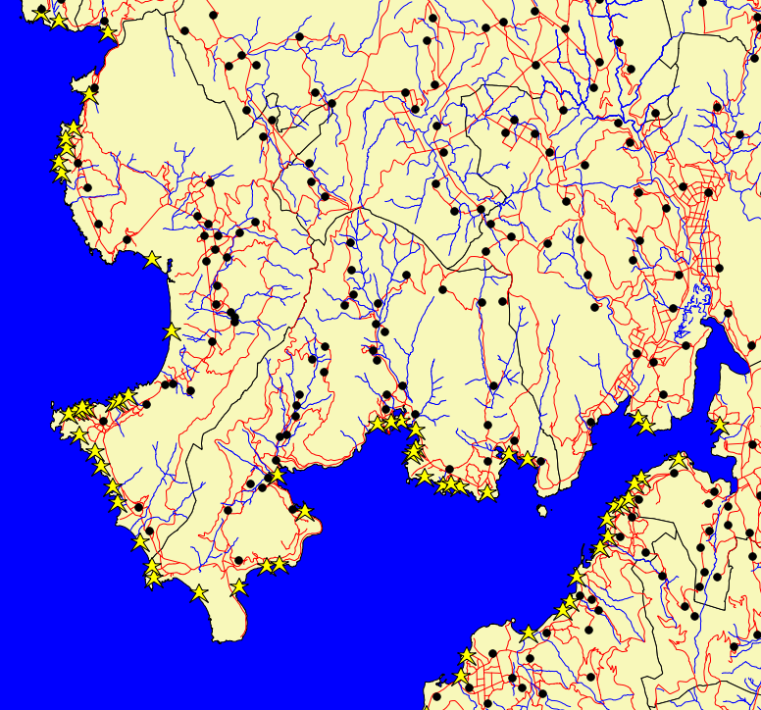
Overview of Geospatial Data Management
Geospatial Data Modeling (2/3)
Geographic Features (Entities, Objects, etc.)
ISO 19109
Entities of a given application domain
  Conventional properties
    String, Numeric, etc.
  Geometric properties
    Geometric Vector Finite Representation
  Temporal properties
ISO 19107
ISO 19108
(x, y)
Points
LineStrings
Polygons

Slide 20
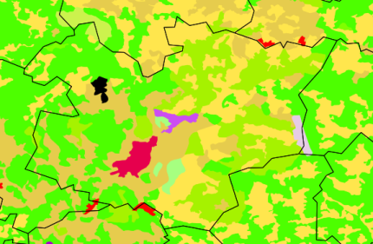
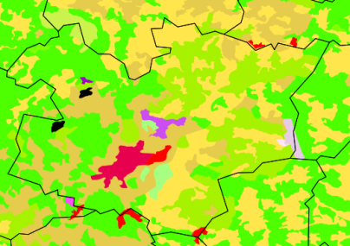
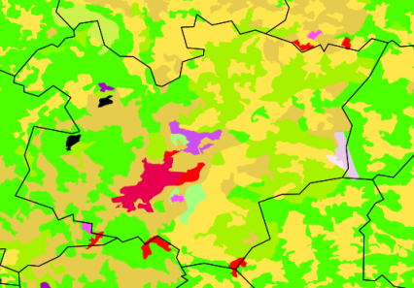

Overview of Geospatial Data Management
Geospatial Data Modeling (3/3)
Geographic Coverages (Fields, Properties of Space, etc.)
ISO 19123
Collections of mappings
  Domain: Spatial, Temporal, Spatio-temporal
  Range: Conventional
Discrete Coverages
  Topological Vector Finite Representation
Continuous Coverages
  Regular Tessellations of Space
    Raster Representation

Slide 21
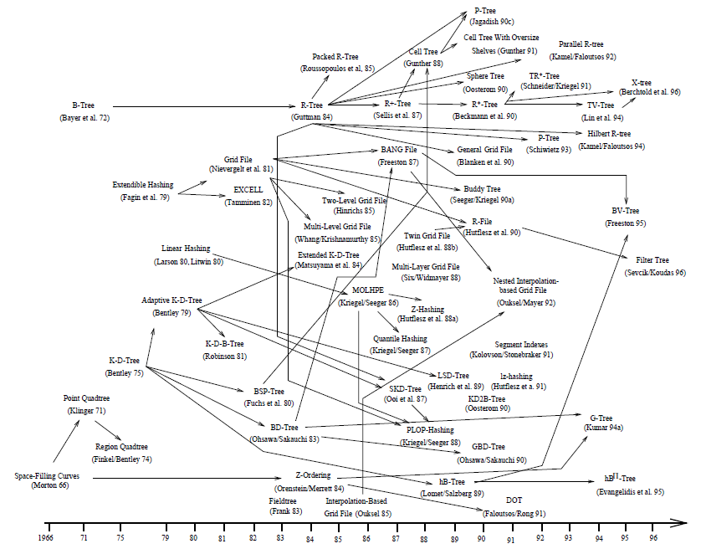
Overview of Geospatial Data Management
Geospatial Data Structures and Algorithms (1/9)
Gaede, Günther 1998
Data Structures

Slide 22



Overview of Geospatial Data Management
Geospatial Data Structures and Algorithms (2/9)
Space Filling Curves (1/3)
Row order
Row-prime
Morton
Samet 2004
Peano-Hilbert
Cantor-diagonal
Spiral
Gray
Dobule-Gray
U-order

Slide 23
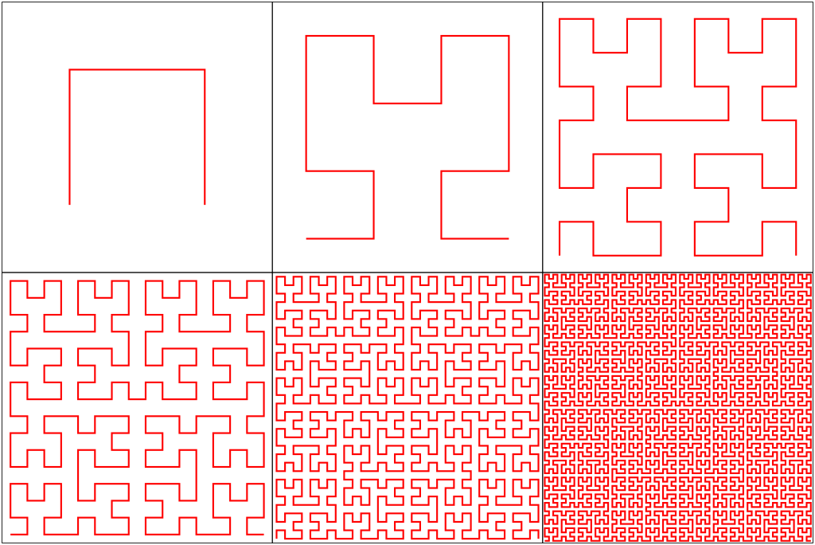
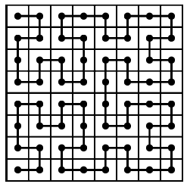

Overview of Geospatial Data Management
Geospatial Data Structures and Algorithms (2/9)
Space Filling Curves (2/3)
Peano-Hilbert
  Complex 2D-1D mapping
  Not stable ordering
  Preserve locality
    No jumps
  Order not admissible
Notes:
Not stable ordering: Relative ordering of locations NOT preserved increasing the resolution if the origin is maintained
Order not admisible: At each location, one 4-neighgour of each direction has NOT already been visited.

Slide 24
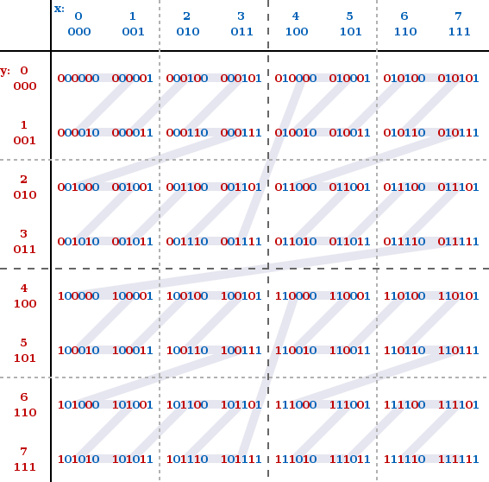
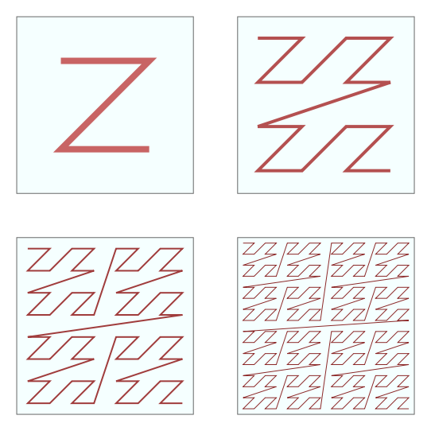
Overview of Geospatial Data Management
Geospatial Data Structures and Algorithms (2/9)
Space Filling Curves (3/3)
Use a 1D Structure!
Hashing
B-tree, B+-tree
Morton
  Simple 2D-1D mapping
    Bit interleaving
  Stable ordering
  Not preserves locality
  Order admissible
Notes:
stable ordering: Relative ordering of locations preserved increasing the resolution if the origin is maintained
Order admisible: At each location, one 4-neighgour of each direction has already been visited.

Slide 25
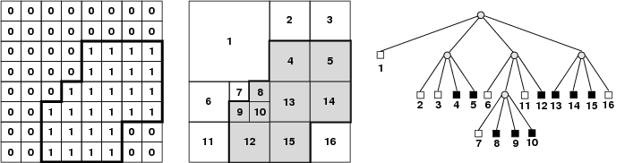
Overview of Geospatial Data Management
Geospatial Data Structures and Algorithms (2/9)
Quadtree
Region Quadtree

Slide 26
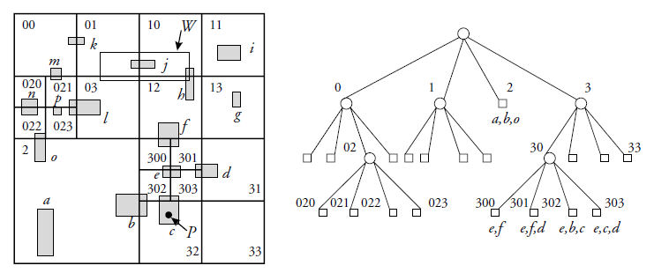
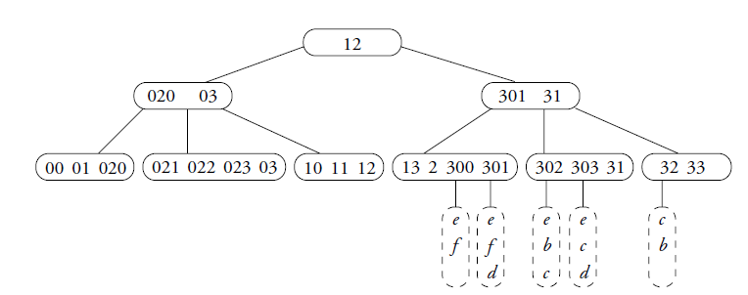
Overview of Geospatial Data Management
Geospatial Data Structures and Algorithms (4/9)
Quadtree
Linear Quadtree
B+tree

Slide 27
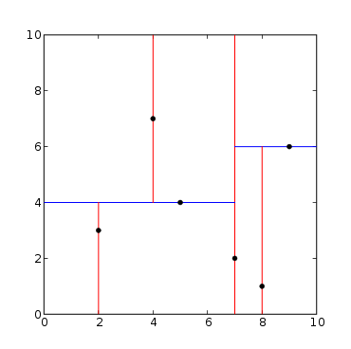
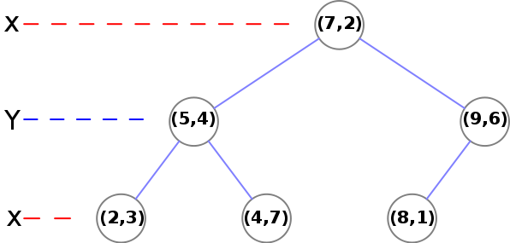
Overview of Geospatial Data Management
Geospatial Data Structures and Algorithms (5/9)
K-D-Tree
Construction
  Use median of axis
Unbalanced
  Balanced variants exist
{(5,4), (2,3), (4,7), (8,1), (7, 2), (9,6)}

Slide 28
Overview of Geospatial Data Management
Geospatial Data Structures and Algorithms (6/9)
x1
Grid File
g3
g3
g1
g1
g5
Directory
p1
Directory
p1 | p2
ScaleX
g2
g2
g4
ScaleX
x1
g4
ScaleY
ScaleY
p1
g1 | g2 | g3 | g4
p1 |  |  |  | p2
g1 | g2 | g5 |  | g3 | g4
x1
x1
Directory
p1 | p2
p3 | p2
g3
Directory
p1 | p2
p3 | p4
g3
g1
g5
g1
g5
g8
g7
g8
g7
ScaleX
x1
y1
ScaleX
x1
y1
g2
g4
g2
g10
g4
ScaleY
g6
ScaleY
g6
y1
y1
g9
p1 |  |  |  | p2 |  |  |  | p3
g1 | g5 | g8 |  | g3 | g4 | g7 |  | g2 | g6
p1 |  |  |  | p2 |  |  |  | p3 |  |  |  | p4
g1 | g5 | g8 |  | g3 | g7 |  |  | g2 | g6 |  |  | g4 | g9 | g10

Slide 29
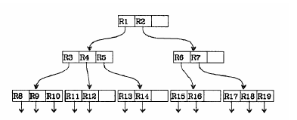
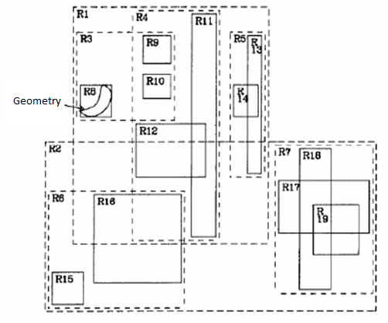
Overview of Geospatial Data Management
Geospatial Data Structures and Algorithms (7/9)
R-Tree
In-depth balanced tree
Number of entries between m and M, where m ∈ [0, M/2]
Root has at least 2 entries
All leaves at the same level
Variants try to reduce overlapping of rectangles
Split nodes
  Minimize total area
  Minimize overlapping
Problem

Slide 30
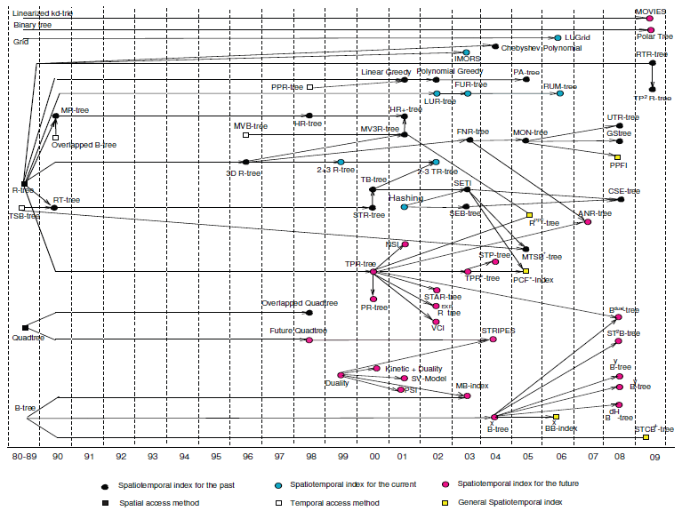
Overview of Geospatial Data Management
Geospatial Data Structures and Algorithms (8/9)
Gaede, Günther 1998

Slide 31
Overview of Geospatial Data Management
Geospatial Data Structures and Algorithms (9/9)
7
Algorithms
6
B
Example: Plane-sweep
  Intersections of a set of rectangles
  Avoid all pair-wise intersections
5
D
4
C
3
2
A
Efficient interval Search
O(log n)
1
E
Active List (interval tree):
1
2
3
4
5
6
7
8
9
10
11
12
Event List: As, Bs, Cs, Ae, Be, Ds, Ce, Es, De, Ee
Active List (interval tree): C[2,4]
Event List:, Ds, Ce, Es, De, Ee
Active List (interval tree): A[1,3], B[5,7]
Event List: Cs, Ae, Be, Ds, Ce, Es, De, Ee
Active List (interval tree): C[2,4], D[3,6]
Event List: Ce, Es, De, Ee
Active List (interval tree): A[1,3], B[5,7], C[2,4]
Event List: Ae, Be, Ds, Ce, Es, De, Ee
Active List (interval tree):D[3,6], E[0, 5]
Event List: De, Ee

Slide 32
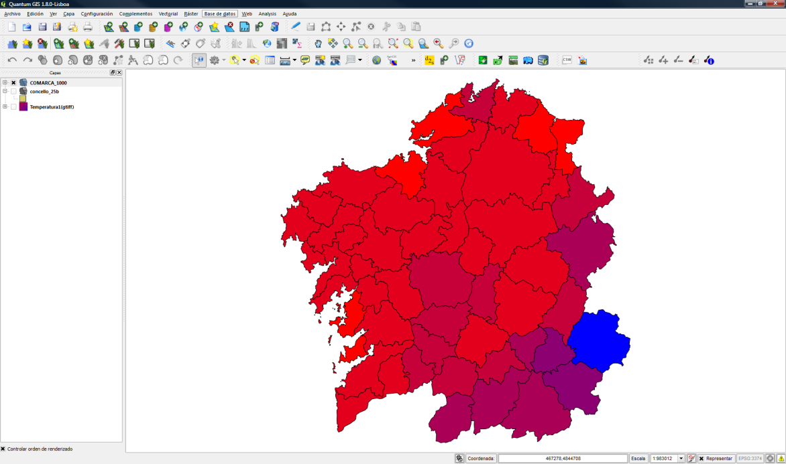
Overview of Geospatial Data Management
Geospatial Data Management Technologies (1/4)
Geographic Information System (GIS)
GUI + Programming APIs
General purpose spatial analysis
Support for features and coverages
Federated access to
  Files
  Databases
  Web Services
Limited management of temporal dimension
Examples (Open Source)
  Quantum GIS
  gvSIG

Slide 33
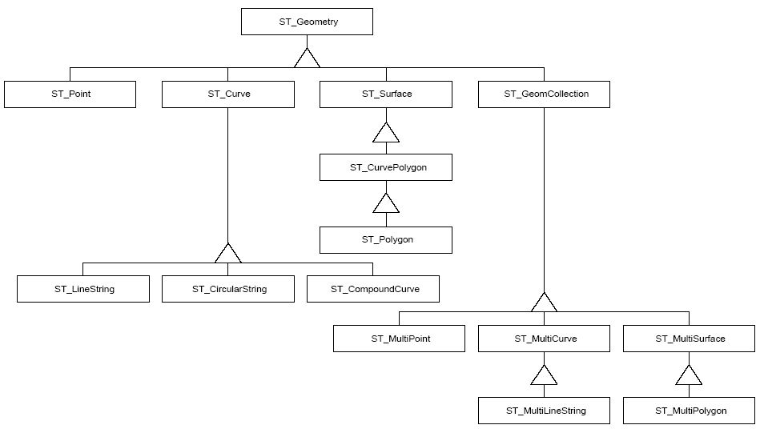
Overview of Geospatial Data Management
Geospatial Data Management Technologies (2/4)
Spatial DBMS (1/3)
Spatial Data Types
ISO SQL/MM Spatial

Slide 34
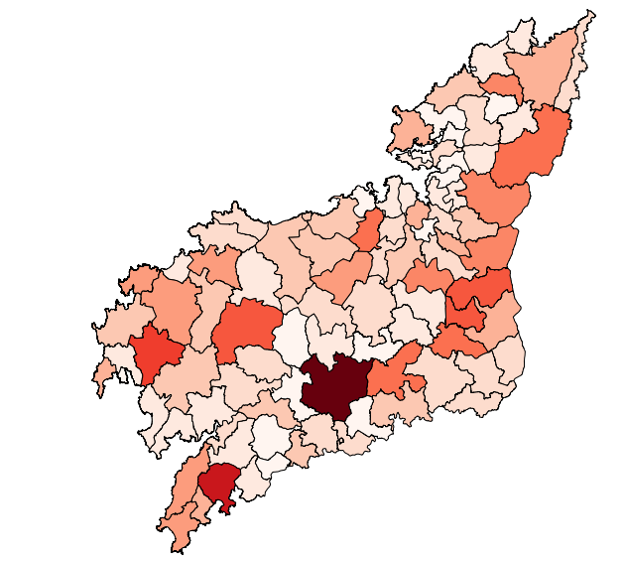
Overview of Geospatial Data Management
Geospatial Data Management Technologies (2/4)
Spatial DBMS (2/3)
ISO SQL/MM Spatial
Spatial Predicates and functions
SELECT m.gid,
m.the_geom,
SUM(st_length(t.the_geom)) as kmBad
FROM municipalities m, road_sections r
WHERE st_contains(m.the_geom, r.the_geom)
AND t.conditions = ‘Bad'
GROUP BY by m.gid, m.the_geom
ST_Disjoint
ST_Touches
ST_Within
ST_Crosses
ST_Overlaps
g1
g2
g2
g2
g1
g2
g1
g2
g1
g1
g1
g2
g2
g1
g2
g1
g2
g2
g1
g1
g2
g1
g2
g1
g2
g1
g2
g1

Slide 35
Overview of Geospatial Data Management
Geospatial Data Management Technologies (2/4)
Spatial DBMS (3/3)
Support for Spatial Indexing
Some of them add also some support for
  Topology
  Raster coverages
Examples (open source)
  Row-wise storage:
    PostgreSQL + PostGIS (http://www.postgis.org/)
  Column-wise storage
    MonetDB Geospatial extension
    (http://www.monetdb.org/Documentation/Extensions/GIS)

Slide 36
Overview of Geospatial Data Management
Geospatial Data Management Technologies (3/4)
Scientific Array DBMS
Large multidimensional scientific arrays as first class citizens
Declarative array data definition and query languages
Distributed architectures for large scale analytics
Examples
  Rasdaman (http://www.rasdaman.org/)
  SciDB (http://www.paradigm4.com/)
Already
Big Data

Slide 37
Overview of Geospatial Data Management
Geospatial Data Management Technologies (4/4)
Big Data for Geographic Features?
Are they needed?
NoSQL Geospatial Technologies
  Still very limited
    MongoDB (http://www.mongodb.org/)
    Geocouch (https://github.com/couchbase/geocouch/)
Geospatial Data Processing
  Spatial partitioning and indexing based on spatial structures
  Distributed implementations of spatial operations
    K Nearest neighbors
    Spatial join
  Examples
    Spatial Hadoop (http://spatialhadoop.cs.umn.edu/)
    GeoSpark (http://geospark.datasyslab.org/)
Notes:
s

Slide 38
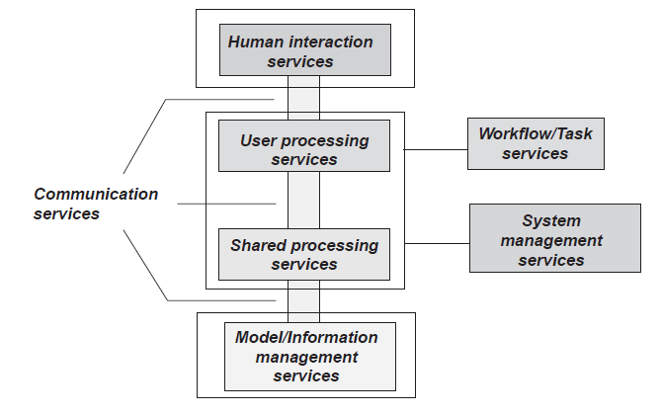
Overview of Geospatial Data Management
Geospatial Data Infrastructures (1/2)
The OGC Service Architecture: ISO/DIS 19119

Slide 39
Overview of Geospatial Data Management
Geospatial Data Infrastructures (2/2)
Model / Information Management Services (1/2)
Feature access service: Service that provides a client access to and management of a feature store.
  OGC Web Feature Service (WFS)
Map access service: Service that provides a client access to a geographic graphics, i.e., pictures of geographic data.
  OGC Web Map Service (WMS)
Coverage access service: Service that provides a client access to and management of a coverage store.
  OGC Web Coverage Service (WCS)
  UNIDATA NetCDFSubset
Examples

Slide 40
Overview of Geospatial Data Management
Geospatial Data Infrastructures (2/2)
Model / Information Management Services (2/2)
Catalogue service: Service that provides discovery and management services on a store of metadata about instances. The metadata may be for dataset instances, e.g., dataset catalogue, or may contain service metadata, e.g., service catalogue.
  OGC Catalougue Service (CSW)
  UNIDATA THREDDS Catalogs
Registry Service: Service that provides access to store of metadata about types. Types are vocabularies that can be organized and related to each other.
Gazetteer service: Service that provides access to a directory of instances of a class or classes of real-world phenomena containing some information regarding position
  OGC Gazetteer Service - Application Profile of the Web Feature Service Best Practice (1.0)
Examples

Slide 41
Overview of Geospatial Data Management
Bibliography
Philippe Rigaux, Michel Scholl, Agnés Voisard. 2001. Spatial Databases with Application to GIS. Morgan Kaufmann Publishers Inc., San Francisco, CA, USA.
Shashi Shekhar and Sanjay Chawla, Spatial Databases: A Tour, Prentice Hall, 2003.
Volker Gaede and Oliver Günther. 1998. Multidimensional access methods. ACM Comput. Surv. 30, 2 (June 1998), 170-231. DOI=http://dx.doi.org/10.1145/280277.280279
Hanan Samet. 2004. Object-based and image-based object representations. ACM Comput. Surv. 36, 2 (June 2004), 159-217. DOI=http://dx.doi.org/10.1145/1031120.1031123
Hanan Samet. 1990. The Design and Analysis of Spatial Data Structures. Addison-Wesley Longman Publishing Co., Inc., Boston, MA, USA.
Aref, W.G., Mokbel, M.F., and Nguyen-Dinh, L. (2010). Spatio-Temporal Access Methods: Part 2 (2003 - 2010). IEEE Data Eng. Bull., 33, 46-55.

Slide 42
Geospatial Information Retrieval
3rd KEYSTONE Training School, TU Wien, Austria. 21-25 August 2017
José R.R. Viqueira
Notes:
10 minutes

Slide 43
Geospatial Information Retrieval
Contents
Introduction
Geographic Information Extraction
Spatio-textual Indexing
Ranking and Evaluation
Bibliography

Slide 44
Geospatial Information Retrieval
Introduction (1/2)
GIS
IR
GIR

Slide 45
Geospatial Information Retrieval
Introduction (2/2)
Query
?
Documents
GeoParsing
Textual Information Extraction
Geographic Information Extraction
GeoCoding
Spatio-textual Indexing
Spatio-textual Searching
Spatio-textual Ranking
Result

Slide 46


Geospatial Information Retrieval
Geographic Information Extraction (1/3)
Geoparsing
NLP
Extension of Named Entity Recognition (NER)
  Supported by Geographic Resources
    Gazetteers, Geo-Ontologies, etc.
Terms
  Place names (Santiago, Wien, London, etc.)
  In general, Geographic Named Entities (Pyrenees, Hilton Hotel, Bernabeu, etc.)
Challenges
  Vague place names (North Spain, Swiss Mittelland, downtown, etc.)
  Vernacular names
    Fuzzy spatial extent and not registered in available resources
  Geo/Non-Geo Disambiguation
    London (Name of a City, Surname, ?)

Slide 47
Geospatial Information Retrieval
Geographic Information Extraction (2/3)
Geocoding (Toponym Resolution)
Toponym Resolution
  Geographic Resources are key
    Gazetteers, Geo-Ontologies, etc.
Challenge
  Geo/Geo Disambiguation
    Santiago (Spain, Cuba, Chile, ?)
Three main categories of approaches (Buscaldi, 2011)
  Map-based: Using distance measures for example.
  Knowledge-based: Exploit external resources (gazetteers, ontologies, etc.)
  Data-driven or supervised: Based on machine learning techniques

Slide 48
Geospatial Information Retrieval
Geographic Information Extraction (3/3)
Obtaining geographic scope (1/2)
Combining the geographic extent of all the extracted Geographic Named Entities
Example 1: (Ding et al 2000) (1/2)
  Geographic scope of document: Geographical area that the creator intends to reach
  Exploiting link structure
    Power(d,g): relative interest in d among the documents of g.
      Computed using links to d from documents in g
    Spread(d,g): power(d,g) is spread smoothly through the extension of g.
      Geographic hierarchy of geographic locations needed
    Candidate Geographical Scope, CGE(d): List of locations with good spread which are not contained in locations already in CGE(d).
    Estimated Geographical Scope, EGC(d): Prune CGE(d) to obtain location with high power.

Slide 49
Geospatial Information Retrieval
Geographic Information Extraction (3/3)
Obtaining geographic scope (1/2)
Combining the geographic extent of all the extracted Geographic Named Entities
Example 1: (Ding et al 2000) (2/2)
  Geographic scope of document: Geographical area that the creator intends to reach
  Exploiting Resource Contents
    Power(d,g): Calculated from the number of references to g in d.
    Spread(d,g): Power(d,g) spread smooly through the geographic extend of g.

Slide 50
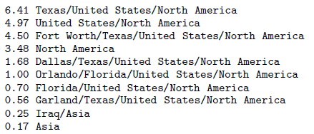
Geospatial Information Retrieval
Geographic Information Extraction (3/3)
Obtaining geographic scope (2/2)
Combining the geographic extent of all the extracted Geographic Named Entities
Example 2: (Amitay et al 2004)
  Each extracted geographic named entity (administrative divisions like Paris for example), has a confidence derived from the disambiguation process.
  It is given a score in the document, based on its confidence and the number of references. Containing entities (France, Europe) are also given some score.
    4 X Orlando/Florida (0.5)
    3 X Texas (0.75)
    8 X Fort Worth/Texas (0.75)
    3 X Dallas/Texas (0.75)
    1 X Garland/Texas (0.75)
    1 X Iraq (0.5)

Slide 51
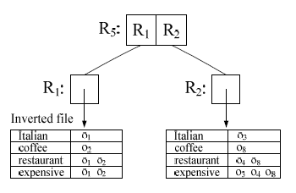
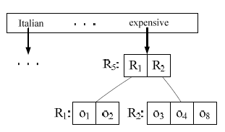
Geospatial Information Retrieval
Spatio-textual Indexing (1/3)
Chen et al 2013
R-Tree Based Indices (1/4)
IF-R* and R*-IF
  They combine the R*-Tree with and Inverted File

Slide 52
Geospatial Information Retrieval
Spatio-textual Indexing (1/3)
Chen et al 2013
R-Tree Based Indices (2/4)
KR*-Tree
  Nodes of R*-Tree augmented with an inverted file of the keywords that appear in the documents of the subtree.
  The inverted file of each node contains references to the specific nodes containing the keywords
IR²-Tree
  Bitmap at each node of the R-Tree with 1 at position i, if term i is in the subtree.
Hybrid Spatial-keyword Indexing (SKI)
  Each non-leaf node augmented with a range of supernodes (nodes just above a leaf-node)
  Each supernode has bitmap version of inverted file. Similar to R*-IF, but using bitmaps

Slide 53
Geospatial Information Retrieval
Spatio-textual Indexing (1/3)
Chen et al 2013
R-Tree Based Indices (3/4)
IR-Tree (and variants)
  Each node N of the R-Tree augmented with an inverted file
    Vocabulary of terms
    Each term has a posting list <(n, u)>. n is a child of N. u is upper bound of text relevance.
  Variants: DIR-tree, CIR-tree and CDIR-tree
IRLi-Tree (named changed in the survey to distinguish from the above)
  Similar to IR-Tree, but it uses a single inverted file for all the nodes
WIR-Tree
  Also variation of IR-Tree
  Partitions the objects into groups sharing as few keywords as possible.
  Each group becomes a leaf node of the WIR-tree. Then the tree is constructed as an IR-Tree
  WIBR-tree uses a bitmap instead of an inverted file

Slide 54
Geospatial Information Retrieval
Spatio-textual Indexing (1/3)
Chen et al 2013
R-Tree Based Indices (4/4)
Spatial Inverted Index (S2I)
  Two different strategies to index frequent and non-frequent terms
  Aggregated R-tree (aR-tree) for each frequent term.
    Each node has maximum impact of the term in the subtree (Like IR-Tree of a single term)
  Inverted file for infrequent terms
    Each posting list organized by blocks of fixed size.

Slide 55

Geospatial Information Retrieval
Spatio-textual Indexing (2/3)
Chen et al 2013
Grid Based Indices
Spatial Primary Index (ST) and Text Primary Index (TS)
  TS outperforms ST.
  Each posting list is associated with a grid cell based on its location
Spatial-Keyword Inverted File (SKIF)
  Used for regions and not for points
  Text part employs an inverted file
  Each grid cell represented by an inverted list
    List of postings (object, spatial idf value).

Slide 56
Geospatial Information Retrieval
Spatio-textual Indexing (3/3)
Chen et al 2013
Space Filling Curve Based Structures
SFC-QUAD
  Inverted file in which the docIDs and frequencies of objects are compressed using OPT-PFD.
  docIDs are assigned an Z-order based on their coordinates
  Maintains a Quad-tree in memory.
    Used to obtain ranges of ids that fall in the query region
  Ranges are merged to reduce the number of I/O operations
  SF2I, Similar but using a Hilbert curve.

Slide 57
Geospatial Information Retrieval
Ranking and Evaluation
Ranking
Use some approach to (text and geographic) score and rank. Combine the two ranks or scores into a single one.
Geographic Similarity
  Euclidean distance, Extent of overlap, Based on containment relations, etc.
Evaluation
GeoCLEF (http://ir.shef.ac.uk/geoclef/)
F. Gey et al. 2007

Slide 58
Geospatial Information Retrieval
Bibliography
J. Ding, L. Gravano, N. Shivakumar, Computing geographical scopes of web resources, in: VLDB '00, San Francisco, CA, USA, 2000, pp. 545-556.
E. Amitay, N. Har'El, R. Sivan, A. Soer, Web-a-where: Geotagging web content, in: SIGIR '04, ACM, New York,NY, USA, 2004, pp. 273-280.
C. B. Jones, R. S. Purves, Geographical information retrieval, International Journal of Geographical Information Science 22 (3) (2008) 219-228.
D. Buscaldi, Approaches to disambiguating toponyms, SIGSPATIAL Special 3 (2) (2011) 16-19.
L. Chen, G. Cong, C. S. Jensen, D. Wu, Spatial keyword query processing: an experimental evaluation, in: PVLDB'13, VLDB Endowment, 2013, pp. 217-228.
F. Gey et al., GeoCLEF 2006: The CLEF 2006 Cross-Language Geographic Information Retrieval Track Overview, Springer Berlin Heidelberg, Berlin, Heidelberg, 2007, pp. 852-876.

Slide 59
Geospatial Semantic Web
3rd KEYSTONE Training School, TU Wien, Austria. 21-25 August 2017
José R.R. Viqueira
Notes:
10 minutes

Slide 60
Geospatial Semantic Web
Contents
Geo-semantics (Janowicz et al 2013)
Geospatial Semantic Data Management (Patroumpas et al 2014)
Bibliography

Slide 61


Geospatial Semantic Web
Geo-semantics (1/5)
Introduction (1/2)
Example 1: Semantics of the term mountain.
  The definitions of feature types are a product of human perception, cognition, current state of knowledge, and social agreement
  No human-independent definition of mountain.
  Minimum Height?
    Principal mountains of England would be hills in the Himalayas
Example 2: Query “towns near forests” with SPARQL
  Misleading result
    City and Town are equivalent in Californian law
    900 different definitions of forest
    Why 25mi is nearby?

Slide 62
Geospatial Semantic Web
Geo-semantics (1/5)
Introduction (2/2)
Geo-semantics research is not interested in overcoming or resolving heterogeneity with global definitions.
Geo-semantics tries to
restrict the interpretation of domain-vocabulary towards their intended meanings
map and translate between local conceptualizations, and
try to reduce the risk of combining incompatible data.

Slide 63




Geospatial Semantic Web
Geo-semantics (2/5)
Geo Linked Data cloud
Stadleret al 2012

Slide 64
Geospatial Semantic Web
Geo-semantics (3/5)
Geospatial Ontologies (1/2)
Common core of concepts:
  Core concepts: location, neighborhood, field, object, network, event
  Information concepts: granularity and accuracy
Need to support multiple resolutions
Define foundational ontologies and extend them by domain ontologies
  Example: SSN + SWEET
Use of ontology design patterns to define local, data-centric and purpose-driven ontologies

Slide 65
Geospatial Semantic Web
Geo-semantics (3/5)
Geospatial Ontologies (2/2)
Enable multiple interpretations for vague terms (mountain, forest, etc.)
Construct ontologies from observations
  Produce an ontology of mountains from Digital Elevation Models
  Discover events (blizzards, rainstorms) from observation data.
Handle vague places (downtown, etc.)
  Fuzzy boundaries that change over time

Slide 66
Geospatial Semantic Web
Geo-semantics (4/5)
Geospatial Semantic Integration
Semantic translation
  Map concepts form one ontology into another one
Geo-ontology alignment
  Combination of multiple ontologies to foster data reuse and integration
Key issue is the computation of semantic similarity

Slide 67
Geospatial Semantic Web
Geo-semantics (5/5)
Semantic Spatial Data Infrastructures
Semantic markup of web services
Transparent and bi-directional proxies between geo-web and semantic web
Semantic annotation of geo data
Semantic Sensor Network (SSN) ontology used to semantically enable the sensor web

Slide 68
Geospatial Semantic Web
Geospatial Semantic Data Management (1/2)
GeoSPARQL (1/2)
OGC Standard (http://www.opengeospatial.org/standards/geosparql)
Ontology for representing features and geometries in RDF
  geo:SpatialObject, geo:Feature, geo:Geometry
  geo:hasGeometry
  sf:Point, sf:LineString, sf:Polygon, etc.
Extension of SPARQL with predicates and functions
  geof:sfIntersects, geof:sfContains, geof:sfWithin, etc.
  geof:union, geof:buffer, geof:distance, etc.

Slide 69
Geospatial Semantic Web
Geospatial Semantic Data Management (1/2)
GeoSPARQL (2/2)
SELECT ?hname
WHERE {
?m a ex:Municipality;
geo:hasGeometry ?mgeo;
geo:hasName
“Santiago de Compostela”^^xsd:String.
?mgeo geo:asWKT ?mwkt.
?h a ex:Hotel;
geo:hasGeometry ?hgeo;
ex:hasName hname.
?hgeo geo:asWKT ?hwkt.
FILTER(geof:sfWithin(hwkt,mwkt))
}
geo:Feature
rdfs:subClassOf
rdfs:subClassOf
ex:Municipality
ex:Hotel
rdf:type
ex:Santiago
ex:hasName
“Santiago de Compostela”
geo:hasGeometry
ex:geoSantiago
geo:asWKT
“Multipoligon(...”
rdf:type
sf:MultiPolygon

Slide 70

Geospatial Semantic Web
Geospatial Semantic Data Management (2/2)
RDF Stores with Geospatial Capabilities
Patroumpas et al 2014
* Currently more: GraphDB, etc.

Slide 71
Geospatial Semantic Web
Bibliography
Krzysztof Janowicz, Simon Scheider, and Benjamin Adams. 2013. A geo-semantics flyby. In RW'13, Springer-Verlag, Berlin, Heidelberg, 230-250.
Kostas Patroumpas, Giorgos Giannopoulos, and Spiros Athanasiou. 2014. Towards GeoSpatial semantic data management: strengths, weaknesses, and challenges ahead. In SIGSPATIAL '14). ACM, New York, NY, USA, 301-310
Claus Stadler, Jens Lehmann, Konrad Höffner, and Sören Auer: LinkedGeoData: A Core for a Web of Spatial Open Data, Semantic Web Journal, 2012

Slide 72
Examples of Ongoing Work
3rd KEYSTONE Training School, TU Wien, Austria. 21-25 August 2017
José R.R. Viqueira
Notes:
30 minutes

Slide 73
Examples of ongoing work
Contents
Example 1: Semantic Mediation of Environmental Observation Datasets
Example 2: Geographic Focus Generation for TV News
Example 3: Federation of LOD Feature and Coverage Datasets
Example 4: Keyword-Based Search over Environmental Data Sources

Slide 74





Examples of ongoing work
Example1: Semantic Mediation of Environmental Observation Datasets (1/5)
Increasingly huge amount of sensor environmental data
Radar
CTD Sampling
Ocean.
Station
+ Devices highly heterogeneous
Radiosounding
Meteo.
Stations
+ Formats and semantics
Ocean.
Station
Meteo.
Station
Meteo.
Stations
+ Spatial / Temporal Resolution
Ocean.
Station

Slide 75


Examples of ongoing work
Example1: Semantic Mediation of Environmental Observation Datasets (2/5)
1st Facet: Heterogeneity of the data sources
  Data modelling paradigms
  Data models (Schemas)
Entity-based Data (In-Situ Devices)
Array-Based (Field) Data (Remote Devices)

Slide 76




Examples of ongoing work
Example1: Semantic Mediation of Environmental Observation Datasets (3/5)
2nd Facet: Semantic Conflicts
Each data source may use different terminology
76

Slide 77








Examples of ongoing work
Example1: Semantic Mediation of Environmental Observation Datasets (4/5)
THREDDS Server
SQL Server
FTP Server
Heterogeneity
ad-hoc
  Prototype 1: Virtual Data Integration solution for sensor observation data (SOSVDI)
  Prototype 2: Semantic Mediation of Sensor Observation Services (SOSSM)
  Prototype 3: Generic adapters for entities [in-situ devices] and ST Arrays [remote devices] (SOSGW)
Wrapper
Radar
Wrapper Array Data
Wrapper DBMSs
Wrapper
Meteo
Wrapper Array Data
Wrapper
NOAA
SOS
SOS
SOS
MEDIATOR
Conflicts
SOS
Internet
Data Integration
Knowledge → Web Ontology Language (OWL) – W3C AND SPARQL
Data Integration
Model

Slide 78
Examples of ongoing work
Example1: Semantic Mediation of Environmental Observation Datasets (5/5)
Regueiro M.A., Viqueira J.R.R., Stasch C., Taboada J.A., Semantic Mediation of Observation Datasets through Sensor Observation Services, Future Generation Computer Systems 67, Elsevier, , pp. 47-56, 2017. Issn: 0167-739X. doi: http://dx.doi.org/10.1016/j.future.2016.08.013.
Regueiro M.A., Viqueira J.R.R., Stasch C., Taboada J.A., Sensor Observation Service Semantic Mediation: Generic Wrappers for In-Situ and Remote Devices, 35th International Conference on Conceptual Modeling (ER 2016), Gifu, Japan, 14 - 17 November 2016.
Regueiro M.A., Viqueira J.R.R., Taboada J.A., Cotos J.M., Virtual integration of sensor observation data, Computers & Geosciences 81, Elsevier, England, pp. 12-19, 2015. Issn: 0098-3004. doi: http://dx.doi.org/10.1016/j.cageo.2015.04.006.

Slide 79

Examples of ongoing work
Example 2: Geographic Focus Generation for TV News (1/3)

Slide 80

Examples of ongoing work
Example 2: Geographic Focus Generation for TV News (2/3)

Slide 81

Examples of ongoing work
Example 2: Geographic Focus Generation for TV News (3/3)

Slide 82
Examples of ongoing work
Example 3: Federation of LOD Feature and Coverage Datasets
GeoSparql End Point
“Limited”
Spatial Data Management
GeoSPARQL Engine
Spatial
Semantic
Storage
R2RML
C2RML
Feature
Data Source
Coverage
Data Source
Spatial DBMS
WFS
Array DBMS
WCS, WCPS

Slide 83

Examples of ongoing work
Example 3: Federation of LOD Feature and Coverage Datasets

Slide 84


Examples of ongoing work
Example 4: Keyword-Based Search over Environmental Data Sources (1/6)
High Sea Surface Temperature
AND Near Camping Miño

Slide 85

Examples of ongoing work
Example 4: Keyword-Based Search over Environmental Data Sources (2/6)

Slide 86







Examples of ongoing work
Example 4: Keyword-Based Search over Environmental Data Sources (3/6)
Property of Space
Fuzzy Linguistic Values
Very Low
Low
Normal
High
Very High
º C
Membership
Raster Tiles
360 x 180 x 20 x 64 bits =
10,04 MB
180
20
360

Slide 87

Examples of ongoing work
Example 4: Keyword-Based Search over Environmental Data Sources (4/6)
Spatial and Temporal
Multiresolution
Pyramids

Slide 88
Examples of ongoing work
Example 4: Keyword-Based Search over Environmental Data Sources (5/6)
Harmonized Vocabulary
+
Index Structure

Slide 89

Examples of ongoing work
Example 4: Keyword-Based Search over Environmental Data Sources (6/6)

Slide 90
Semantic Keyword-based Search on Geospatial Data Sources
Thank you!
https://citius.usc.es/equipo/persoal-adscrito/jose-ramon-rios-viqueira
jrr.viqueira@usc.es

