Slide 1
Scalable Linked Data Quality Assessment
Jeremy Debattista
ADAPT Centre, Trinity College Dublin
3rd Keystone Summer School 2017
The ADAPT Centre is funded under the SFI Research Centres Programme (Grant 13/RC/2106) and is co-funded under the European Regional Development Fund.

Slide 2
Quality: A definition from a Personal Perspective
What does quality mean to you?
Crowd Image by James Cridland, taken from https://www.flickr.com/photos/jamescridland/613445810/. Licensed under CC-BY 2.0
Notes:
If we go in that crowd and ask each and every person to define quality from their perspective, we will probably get different answers…
So, let me ask you, “what does quality mean for you?” (wait for some response, if not ask someone)

Slide 3
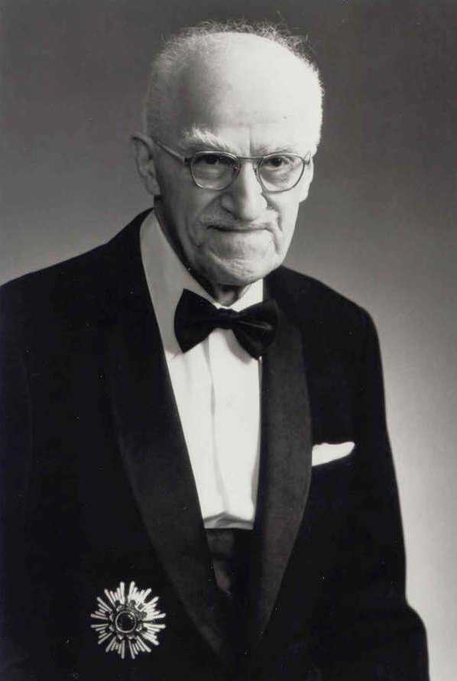
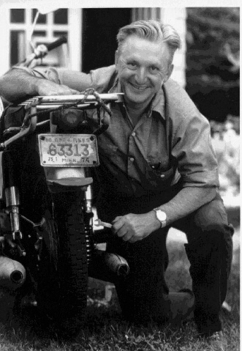
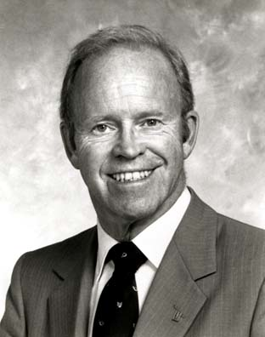
Quality: A definition
Joseph Juran
Robert Pirsig
Phillip Crosby
Notes:
These 3 people here are
Robert Pirsig – an writer and philosopher
Joseph Juran – an engineer
Phillip Crosby – a businessman
What do they have in common? – just like you, they all tried to define the term quality quality

Slide 4
Quality: A definition – Pirsig’s Perspective
… the result of care
Zen and the Art of Motorcycle Maintenance (1974)
Robert Pirsig
Notes:
Whilst on a 17 day journey across America, Pirsig explores the concept of quality and tries to define it as the result of care.
Although hinting that the term quality is undefinable.

Slide 5
Quality: A definition – Juran’s Perspective
… fitness for use
Quality Control Handbook (1974)
Joseph Juran
Notes:
For Juran, the term quality means “fitness for use”

Slide 6
Quality: A definition – Crosby’s Perspective
… conformance to requirements
Quality is Free : The Art of Making Quality Certain. Mentor book. (1979)
Phillip Crosby
Notes:
Similar to Juran views, Crosby defines quality as conformance to requirements
.. As you can see the definition of quality is subjective. These guys had different definitions, just as you had.

Slide 7
Data Quality – Why is it important?
What characterised good quality for the datasets you needed to perform a task?
Notes:
but how is quality pertinent to data? What is data quality?
Before going into that question, how many of you work with data, or consider themselves to be data consumers? *show of hands*
Click: Then, I would like to ask you this question

Slide 8








Importance of Data Quality
Quality in terms of data is:
Multi-dimensional concept
Characterise quality for a particular task
Variety of quality measures, Subjective or Objective for different tasks
  e.g. Accessibility, Trustworthiness, Consistency
High quality data = data that fits for its intendend use.
DATA
Notes:
In recent years, data became an indispensible commodity.
A lot of heterogenous sources, such as personal devices, transport, drones, satellites, sensors etc.. are providing huge amounts of data.
This data brought a number of opportunities in business processes and humans day-to-day lives.
However, these also brought a number of challenges, including data quality, as in this data-dependent world, poor quality can lead to adverse consequences including social and economical problems
transport application scenario
But what do we mean by data quality?
Quality in terms of data is a multidimensional concept and therefore in order to characterise the quality of certain data for a particular task, one requires a variety of subjective and objective quality measures to be computed (e.g. accessibility or trustworthiness).
However the same data can be assessed upon different measures due to the different uses of data.
Data is generally considered high quality if it is fit for its intended use.

Slide 9
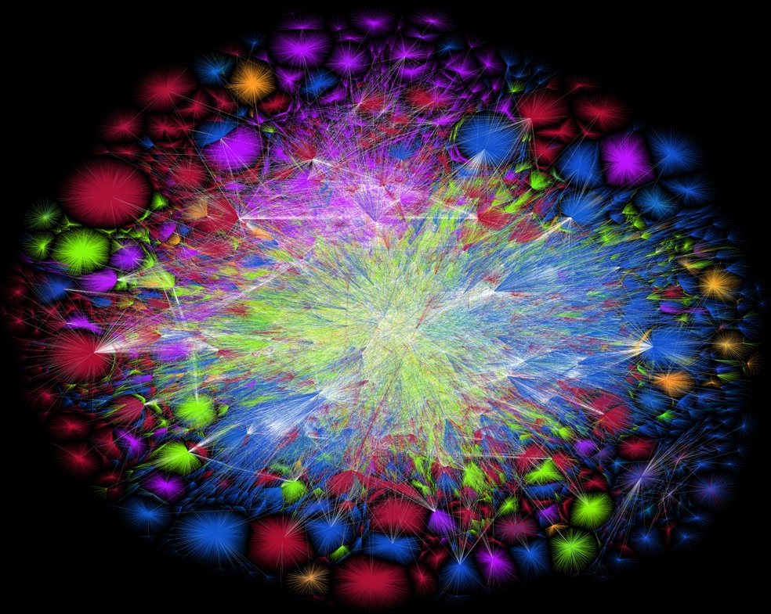
The Problem and Challenges
Detecting data quality problems in different sized datasets;
Making information about data quality readily available for public consumption;
Identifying the right data quality indicators for the task at hand;
Continuously assessing data quality in dynamic datasets;
…
The Internet 2015 is licensed under a CC-BY-NC 4.0 © 2014 by LyonLabs, LLC and Barrett Lyon - http://www.opte.org/the-internet/
Notes:
Ok so now you should have understood what data quality is and have an idea why it is important. But what is the problem?
the problem with this huge amount of data is to try and filter relevant good quality data sources for the task at hand
To mitigate this problem quality-driven mechanisms should be embedded in data-centric processes, however this poses a number of challenges, for example
Dealing with time and space complexities when detecting data quality problems
Making quality information accessible to data consumers
Helping data consumers in choosing the right quality metrics for the task at hand and
Re-assessment of continously evolving data and datasets, amongst others

Slide 10
Lecture Overview
Conceptual Methodology for Assessing Data Quality
SoTA in Linked Data Quality Assessment
Assessing Large Linked Datasets
Representing Quality Metadata
Outlook towards the Quality of the Web of Data
Assessing Ontology Quality
Conclusions
Notes:
Following our introduction on quality, the rest of the lecture will cover the following:
First we look at a conceptual methodology for assessing data quality – here I will briefly discuss the steps required to assess datasets to characterise fitness for intended use
We then look at the state of the art in linked data quality assessment, going into some detail of how RDF unit and Luzzu work
Following that, we will discuss linked data quality metrics and how probablistic techniques can improve their computational time whilst still giving a acceptable results
We then look at how quality assessment results can be described using ontologies
I will also give an overview on the quality of the datasets making up the previous LOD cloud
And finally before my take home message, I will present some of the work my master student is doing on assessing ontology quality and his proposed framework linking two semantic-based tools to help users find better fit ontologies for their task at hand.

Slide 11
Lecture Overview
Conceptual Methodology for Assessing Data Quality
SoTA in Linked Data Quality Assessment
Assessing Large Linked Datasets
Representing Quality Metadata
Outlook towards the Quality of the Web of Data
Assessing Ontology Quality
Conclusions
Notes:
In order to enable the characterisation of fitness for intendend use based on a specific task, I will explain a holistic conceptual methodology

Slide 12
Quality Assessment – A Conceptual Methodology
Identify Quality Measures for the task at hand
  What are the important characteristics of my task?
Re-use or define quality metrics
Prepare the quality assessment
  Access point of dataset in question
  External Resources such as gold standard
Running the quality assessment
Assessment representation
  Immediate use
  Mid-to-long term use
J. Debattista, S. Auer, C. Lange. Luzzu - A Methodology and Framework for Linked Data Quality Assessment. In ACM Journal of Data Information Quality. V8 I1, November 2016
Notes:
In the first step, the stakeholder, identifies the important quality metrics for the task at hand. Basically at this point we identify the important characteristics of my task, for example I require that the resources in this dataset are updated regularly. As explained in the challenges, different tasks would require that datasets are assessed over different metrics.
For each identified metric, the stakeholder than has to either reuse the metric in a quality assessment tool, or define the metric in a declerative or procedural manner, depending on the assessment tool used.
Then, the stakeholder should prepare the candidate dataset access point (e.g. location of data dump or sparql endpoint) and any required external sources that are required for the completion of the assessment such as gold standards.
Using this information the quality framework runs the assessment, assessing each triple on the metrics conditions, and recording quality results and problems.
Finally, any assessment output can be either used immediately, for example problem reports can be used in data cleaning solutions; or long-term use, for example quality metadata results can be used for ranking.

Slide 13
Lecture Overview
Conceptual Methodology for Assessing Data Quality
SoTA in Linked Data Quality Assessment
Assessing Large Linked Datasets
Representing Quality Metadata
Outlook towards the Quality of the Web of Data
Assessing Ontology Quality
Conclusions

Slide 14
Linked Data Quality Frameworks – Over the Years
 | Flemming | LinkQA | Sieve | RDF Unit | Triple Check Mate | LiQuate | TRELLIS | tRDF/tSPARQL | WIQA | Luzzu
Scalability | X | ✓ | ✓ | ✓ | N/A | N/A | N/A | ✓ | N/A | ✓
Extensibility | X | Java | XML | SPARQL | X | Bayesian Rules | X | tSPARQL Rules | WIQA PL | Java or LQML
Quality Metadata | X | X | ✓ (Optional) | ✓ (DQV) | X | X | X | X | X | ✓(daQ)
Quality Report | HTML | HTML | X | HTML or RDF | X | X | X | X | X | RDF
Collaboration | X | X | X | X | ✓ | X | ✓ | X | X | X
Cleaning Support | X | X | ✓ | X | X | X | X | X | X | X
Last Update | 2010 | 2011 | 2014 | 2017 | 2013 | 2014 | 2005 | 2014 | 2009 | 2016
J. Debattista, S. Auer, C. Lange. Luzzu - A Methodology and Framework for Linked Data Quality Assessment. In ACM Journal of Data Information Quality. V8 I1, November 2016
Notes:
Over these last years there was a number research works that described different data quality framework for linked data
In this section we will mention and compare 10 frameworks, going into a bit more detail for 2 of these frameworks
Flemming provides a simple web user interface and a set of metrics related to the publishing of Linked Data. Users can input their dataset and give weights to the different metrics provided. The framework cannot be extended and a problem report highlighting quality issues found in the dataset are generated in HTML format
LinkQA is an assessment tool used to measure the quality of a dataset using network analysis measures. New network-based metrics can be added to the tool. Similar to Flemming, a quality problem report is generated in HTML format
Sieve uses metadata about named graphs to assess data quality where custom metrics can be defined using an XML-like configuration. Unlike the rest of the tools in this table, Sieve has its own data cleaning process, correcting or removing incorrect data from a dataset.
RDF unit provides a test-driven quality assessment for linked data using SPARQL templates. Different SPARQL patterns can be added to extend the framework and quality metadata is provided following an assessment using the W3C data quality vocabulary. We will talk more about RDF unit in the next slide
Triple checkmate is a crowd sourcing tool for linked data quality assessment, supported by semi-automatic verification.
Liquate analyse the quality of datasets identifying potential quality problems and ambiguities using bayesian networks. New metrics can also be added using bayesian rules
Trellis is another crowd source tool enabling users to annotate facts based on subjective observations, opinions and conclusions
tRDF framework provides a number of trust assessment metrics to determine how trustworthy the RDF statements are. This framework can be extended using the tSPARQL specification
WIQA is an assessment framework with policies based on provenance and background context related to data providers.
Finally, Luzzu is an extensible quality assessment framework, where users can create their own metrics using Java or the Luzzu quality metric language. Assessment results are described as linked data using the daQ vocabulary and quality report can be fed to other semantic-based cleaning tools. We will discuss luzzu and other features of this framework during this lecture.

Slide 15

RDFUnit – Unit Testing Framework for RDF
Test-driven Development
Ensuring quality for ontologies, vocabularies and knowledge basis
SELECT ?s WHERE {
?s dbo:birthDate ?v1 .
?s dbo:deathDate ?v2 .
FILTER ( ?v1 > ?v2 ) }
Example Test Case
https://github.com/AKSW/RDFUnit
D. Kontokostas, P. Westphal, S. Auer, S. Hellmann, J. Lehmann, R. Cornelissen, A. Zaveri. Test-driven Evaluation of Linked Data Quality. In: Proceedings of the 23rd International Conference on World Wide Web. WWW ’14. Seoul, Korea: pp. 747–758. doi: 10.1145/2566486.2568002 .
Notes:
RDFUnit is a framework supporting test-driven development
The idea is that ontologies, vocabularies and knowledge bases are accompanied by a number of test-cases, ensuring a basic level of quality
An example test case would be that a person should never have a birth date after a death date

Slide 16
RDFUnit – Unit Testing Framework for RDF
A Library of Data Quality Test Patterns
Pattern | Bindings | Instantiation
SELECT ?s WHERE { ?s %%P1%% ?v1 . ?s %%P2%% ?v2 . FILTER ( ?v1 %%OP%% ?v2 )} | P1 => dbo:birthDate P2 => dbo:deathDate OP => “>” | SELECT ?s WHERE { ?s dbo:birthDate ?v1. ?s dbo:deathDate ?v2. FILTER ( ?v1 > ?v2 ) }
Test Auto Generators
D. Kontokostas, P. Westphal, S. Auer, S. Hellmann, J. Lehmann, R. Cornelissen, A. Zaveri. Test-driven Evaluation of Linked Data Quality. In: Proceedings of the 23rd International Conference on World Wide Web. WWW ’14. Seoul, Korea: pp. 747–758. doi: 10.1145/2566486.2568002 .
Notes:
RDFUnit has a number of abstract data quality test patterns, each of which can be further refined into concrete data quality test cases using test pattern bindings
So in this example we see that we have two property bindings related to the birthdate and deathdate and an operator
RDFUnit also support auto generation of tests where the framework takes the schemas being used and check for any constraints defined in these schemas. The framework will generate patterns based on these constrains and test the dataset for any violation

Slide 17
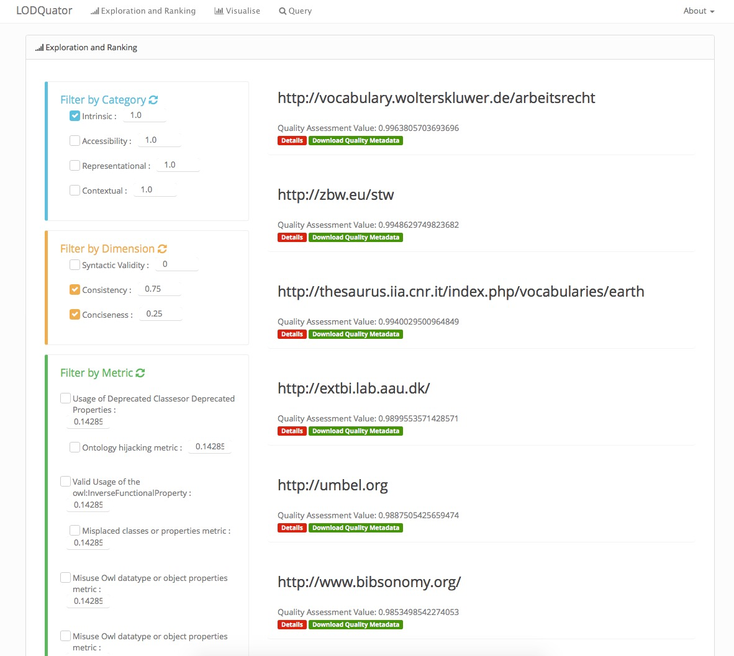


Luzzu – A Quality Assessment Framework for Linked Data
J. Debattista, S. Auer, C. Lange. Luzzu - A Methodology and Framework for Linked Data Quality Assessment. In ACM Journal of Data Information Quality. V8 I1, November 2016
Four Principles:
  Extensibility
  Scalability
  Interoperability
  Customisability
Metric 1
Metric 2
Metric 3
…
Metric n
Metrics Identification
List
Metrics Impl. Library
Quality Metadata
<s,p,o>
Dataset /
SPARQL Endpoint
Stream Processing
Thread Pool
Quality Problem
Report
Luzzu
http://www.github.com/eis-bonn/Luzzu
Notes:
Luzzu is implemented with 4 principles in mind, which I will explain next
The first principle is extensibility. Third parties can define and use custom domain specific quality metrics, related to both the inherent aspects of data and extrinsic aspect of data. These metrics can be defined in a imperative or declerative fashion, with the latter using the Luzzu Quality Metric Language.
Scalability is the second principle. In luzzu, data is processed in a streaming fashion in order to ensure a linear running time.
The third principle is Interoperability. Luzzu is built on top of a number of semantic vocabularies, ensuring that outputs can be reused in other semantic frameworks
The fourth principle is Customisability where, users can create task-dependent quality profiles, giving different weight to different quality aspect for quality-driven filtering and ranking.

Slide 18
Luzzu Quality Metric Language
Domain Specific Language for quality metrics
Declarative style of definition
Aim: Simplify quality definition
def{NoBlankNodeMetric}:
metric{<http :// purl.org/eis/vocab/dqm#NoBlankNodeMetric>};
label{"Usage of blank nodes."};
description{"Calculates the percentage of blank nodes used in a dataset."};
rule{
var.x = match{isBlank(?s)} => action{count(?s)};
var.y = match{isBlank(?o)} => action{count(?o)}; };
finally{ratio(add(var.x, var.y),totalTriples)} .
An LQML Example defining the No Blank Nodes Metric
Notes:
Quality metrics can be defined using the Luzzu Quality Metric Language, a declarative domain specific language that enables experts and non-experts alike to define their own quality metrics.
with LQML, we aim to lower the barriers of defining quality metrics and thus encouraging even more stakeholders to assess the quality of linked datasets.
LQML is a light-weight rule-based language that allows users to express aggregation, numeric, rdf-specific and user-defined functions.
For example, the definition shown in the box demonstrates how a user can define a metric that finds the percentage of blank nodes in a dataset

Slide 19
Luzzu Data Processors
Stream Processor
  Triple streaming from data dump on disk
SPARQL Processor (Different than RDFUnit!)
  Triple streaming from SPARQL endpoint
  Potential problems and super expensive (Order by + Offsets)
SPARK Processor
  Triple streaming for resilient distributed datasets
In-Memory Processor
  Loads data dump in main memory for triple streaming
HDT-Processor (Next in pipeline)
  Triple streaming from HDT files
Notes:
In Luzzu there are currently 4 data processors:
a stream processor that streams triples or quads one by one directly from a data dump on disk;
a SPARQL processor that streams triples from a SPARQL endpoint; in this case luzzu queries a knowledge base endpoint to retrieve all triples from a KB, using order by and offsets to make sure to get all triples once. this is super expensive and could run into potential problems for example time outs etc..
a SPARK processor that streams triples from resilient distributed datasets;
an in-memory processor streams triples from the systems main memory; usually this is great for small datasets unless you have some 1TB of ram available
and in the future an HDT processor – you will hear a lot more about HDT tomorrow

Slide 20
Lecture Overview
Conceptual Methodology for Assessing Data Quality
SoTA in Linked Data Quality Assessment
Assessing Large Linked Datasets
Representing Quality Metadata
Outlook towards the Quality of the Web of Data
Assessing Ontology Quality
Conclusions

Slide 21
Linked Data Quality Metrics
Contextual Category:
Metrics dependent on the task at hand.
e.g. Trustworthiness, Relevancy, Provenance…
Representational Category:
How well is the data represented in terms of common best practices and guidelines?
e.g. Interoperability, Versatility…
Availability Category:
Are Linked Data resources readily available to be re-used in different applications/context etc…?
e.g. Availability of Resources, Licensing, Server Performance
Intrinsic Category:
Independent of the user’s context
e.g. Syntactic Validity, Consistency, Completeness…
A. J. Zaveri, A. Rula, A. Maurino, R. Pietrobon, J. Lehmann, and S. Auer. Quality Assessment for Linked Data: A survey. Semantic Web Journal, 2015.
Notes:
Through out the years, various work, working groups, researchers etc.. Pointed out different measures that one should take in order to have high quality data.
In the Linked Data spectrum, we had various researchers identifying different quality metrics, mostly merging ideas from other communities and also based on linked data publishing best practices.
In a recent survey paper, zaveri et al. have looked into the various quality metrics that were being proposed and classified them in 4 categories and a number dimensions
In total there where 69 metrics classified into 18 dimensions and 4 categories. Let us briefly describe each category
**CLICK** The accessibility category address the ease with which machines as well as humans can re-use linked data resources
**CLICK** The representational category groups metrics that are related to the design of data
**CLICK** The contextual category groups dimensions and metrics that are highly dependent on the task at hand, e.g. the relevancy of a dataset or the trustworthiness.
**CLICK** The intrinsic category measures metrics that are related to the correcteness and coherence of the data.

Slide 22
Linked Data Quality Metrics
Do you know some quality metrics for each of the categories mentioned?
Notes:
Another question for the audience

Slide 23


Linked Data Quality Metrics - Accessibility
Availability of SPARQL endpoints and RDF Data Dumps
Dereferenceability of resources
Indication of machine/human readable license
Links to external datasets
Correct usage of hash/slash URIs
?
303 See Other
200 OK
Notes:
So to give you an idea of the metrics in the accessibility dimension we find:
the availability of sparql endpoints and rdf data dumps – one way of checking this is to check for predicates related to distributions or endpoints in schemas such as void and dcat
dereferencability of resources is the process that retrieves a requested resource from the web. More specifically such a metric checks if resources follow the best practises and check if resources are using 303 see other.
Check if the dataset has a mention of some machine readable license or maybe a predicate with textual license
Another metric could be to check the interlinking extent of the dataset with other external sources
and maybe also checking whether a resource is using the correct hash or slash uris according to the amount of data – hash URIs when there are millions of triples might lead to performance issues when requesting the resource (imagine dbpedia using hash URIs, each time we try to retreive some resource, we end up downloading the whole KB)

Slide 24
Linked Data Quality Metrics - Intrinsic
Syntactic valid dataset
Incorrect datatype specification (e.g. “23.42”^^xsd:integer)
Outlier detection
Correct domain and range definition
Data conciseness
Notes:
with regard to the intrinsic category we have metrics such as:
checking the syntax validity of the dataset in question. if there are syntax errors the consumer might have problems in using that data
checking for the lexical syntax of literals, for example raising an error when the 23.42 literal has a datatype of integer attached to it
detect anomalies in data
check if predicates are using the correct domain and range types as defined in their schema
check for potential duplicate data

Slide 25
Linked Data Quality Metrics - Contextual
Trustworthiness of data
Identification of timely data
Provenance information
Notes:
With regard to the contextual category we find metrics such as:
checking for the trustworthiness of statements or information provider
checking for the data’s freshness
checking for provenance information, for example if a resource has metadata information related to its creation/modification etc…

Slide 26
Linked Data Quality Metrics - Representational
Re-using existing vocabularies
Usage of undefined classes/properties
Provide different serialisation formats for the data
Use of multiple languages
Notes:
With regard to the representational category we have metrics like those for:
checking if a dataset is using vocabularies that were already defined for their domain. for example one potential solution for data publishers is to use services such as LOV to search for datasets in that particular domain
checking if the dataset is using types or predicates there were not previously defined. so basically this metric dereferences and queries the vocabulary of the predicate or the type in question to check if the concept exists
check if a dataset is available in different serialisation formats e.g in turtle, rdf/xml, json-ld etc…
and finally check if human readable labels and comments in resources are available in different languages to widen the audience

Slide 27
Problems with Assessing the Quality of Big Datasets
Metrics classified in Zaveri et al. did not take into consideration time and space complexity
Efficient computation of impractical quality metrics when assessing big datasets
  Solving intractable problems?
Trade-off? Faster computation time against metric’s value precision
J. Debattista, S. Londoño, C. Lange, S. Auer. Quality Assessment of Linked Datasets using Probabilistic Approximation. In 12th European Semantic Web Conference Proceedings 2015, 221-236, Springer
J. Debattista, C. Lange, S. Auer. A Preliminary Investigation Towards Improving Linked Data Quality using Distance-Based Outlier Detection. (Short Paper) In: Li YF. et al. (eds) Semantic Technology. JIST 2016. Lecture Notes in Computer Science, vol 10055.
Notes:
When we started implementing metrics as described in the related literature, we noticed that large datasets brought unpredictable behavior in terms of size and time.
This occurred since related literature aim was not scalability, but describing the quality issues.
For example in some linked data quality metrics, one has to deal with external factors, such as network access latencies, which even in linear time metrics such as dereferencability, the larger the dataset being assessed, the more time it takes to finish its computation.
This is because of the large number of http requests done on the external server.
we thought we could find a way to decrease the computational time in order of magnitudes and space with the expense of the quality value precision.

Slide 28
Approximation Techniques for Data Quality Metrics
Sampling
Dereferenceability Metric
Links to External Data Providers Metric
Bloom Filters
Extensional Conciseness
A technique to reduce the space, selecting a sub-set of the dataset to assess the metric upon.
A fast and space efficient bit vector data structure used to query elements in a set.
Notes:
Here I present two probabilistic techniques that were applied on different quality metrics to improve their space and time complexity.
The sampling techniques was applied in cases where we needed to reduce the data space of the assessed datasets, by selecting a subset of the data to be used during assessment.
These are mostly used in linear time quality metrics but are affected by external factors.
Probabilistic techniques can also be used to shift the time complexity of a metric from polynomial time to linear using bloom filters, a fast and space efficient bit vector, as in the case of the Ext cons metric
Lets go into more detail for these two techniques
sampling a technique to reduce the space, selecting a sub-set of the dataset to assess the metric upon
bloom a fast and space efficient bit vector data structure commonly used to query for elements in a set
random walker identifies a subgraph that will be used during the quality assessment, from the graph using a walker that stops when the mixing time is reached
distance clusters a set of data objects together on a 2d plane based on their distance
deref: assesses URIs for hash uris or 303s
link: assesses the degree of resources linked to external data sources
ext: assesses the uniqueness of resources in a data source
cco: assesses how well resources are connected together by measuring the density of a resource neighbourhood
out: assesses the outlier resources (non literals) in a dataset

Slide 29
Data Sampling
Selection of subset of individuals from a population
Various techniques e.g. Reservoir, Stratified, Clustered, Systematic
J. Debattista, S. Londoño, C. Lange, S. Auer. Quality Assessment of Linked Datasets using Probabilistic Approximation. In 12th European Semantic Web Conference Proceedings 2015, 221-236, Springer
J. Debattista. Scalable Quality Assessment of Linked Data. (Thesis) Universitäts-und Landesbibliothek Bonn 2017
Notes:
The first technique we will describe is Data Sampling.
Sampling deals with the selection of a subset of individuals from a population, with the aim of estimating the characteristics of the whole population
There are numerous techniques that one can use for sampling data, for example reservoir, stratified, clustered, systematic sampling
However here we explore two of these: reservoir sampling and stratified sampling

Slide 30
Reservoir Sampling
A statistical based technique, facilitating the sampling of evenly distributed items
Rejection-Acceptance
1
2
3
4
5
6
7
8
2
10
14
SAMPLE
9
10
11
12
5
6
12
13
14
15
16
In-Memory Reservoir
Dataset Elements
Notes:
reservoir sampling is a statistical based technique, facilitating the sampling of evenly distributed items
in reservoir sampling each item has an equal chance of making it to the final reservoir, using a replacement probability
so in the image shown, each item numbered 1 to 16, has 3/8th chance of being in the reservoir sampler, because the algorithm has to select 6 elements from 16

Slide 31
Stratified Sampling
A probability sample is drawn from distinct groups (strata) within the whole population
Proportionate allocation method
1
2
3
4
5
6
7
8
2
8
14
SAMPLE
9
10
11
12
9
4
12
13
14
15
16
In-Memory Reservoir
Dataset Elements
Notes:
stratified sampling is a technique where a probability sample is drawn from distinct groups or strata within the whole population, using a proportionate allocation method
meaning that the sample chosen is more representative of the distinct groups from the whole population
A typical example is the European Union parliament, where the allocation of MEPs is made per capita, for example the least populated country, malta has 6 MEPs but germany, the most populated country has 96 MEPs
how did we use sampling in the dereferencability metric?

Slide 32


Approximating Dereferenceability using Sampling
Dereferenceability Metric - the process that retrieves a representation of the requested resource from the network
2-level sampler representation
Extra step for proportionate allocation in stratified sampling
<http://dbpedia.org/resource/Bonn>
<http://dbpedia.org/resource/Bonn>
Calculate Replacement
Probability
Is the Sampler full?
But what if it is full?
Key | Value
http://kdata.kr | [/resource/Gurokkumnamu_Library, ...]
http://bfs.270a.info | [/clas/2010.3/CL_HGDE_GDE, ... ]
...
http://dbpedia.org
[/resource/Bonn]
Dictionary as an illustration example
Notes:
first of all, dereferencability is the process that retrieves a requested resource from the web, therefore the metric itself is relying on various external issues such as latency
for this metric we use a 2-level sampler, simulating a dictionary, for both the reservoir sampler and stratified sampler.
The higher level sampler (or the key) samples the URI authoritive domain, and similar to a dictionary, a domain can only be represented once in the sampler. The sampler has a finite size
For each authorative domain, we have another sampler, a lower-level sampler or value in terms of dictionaries, that samples the domain’s resources. The lower-level sampler is also of a finite size but can have duplicate elements
So taking the domain of the resource, we first check if the sampler is full, if not, then we just add the item
But what happens if the sampler is full?
The algorithm will calculate a replacement probability for the item in question.
This probability will identify whether this item should be accepted in the sampler by replacing another item, or reject.
Similarly, the same algorithm is used to accept or reject resources in the lower-level sampler
The major difference in stratified sampling is that for each domain in the higher-level sampler, we keep track of the total number of items encountered during assessment, to simulate the size of the strata groups, therefore a final sampler is then drawn from all lower-level sampled resources using the proportionate allocation method.

Slide 33



Bloom Filters
A fast and space efficient bit vector data structure commonly used to query elements in a set.
Supercalifragilisti-cexpialidocious
Probably in the set
Notes:
The second technique I will discuss is bloom filters.
Imagine we want to know if a word exists in the english language. There are a couple of ways to do that, by either look for the word in a dictionary or else encode the dictionary in a bit vector structure and used bloom filters.
a bloom filter is a fast and space efficient bit vector data structure that is commonly used to query elements in a set.
However, bloom filters will not tell me that the word definitely exists in a set, but will only tell me that the word I am looking for does not exists or it probably exists.

Slide 34
Approximating Extensional Conciseness Using Bloom Filters
Extensional Conciseness metric - an instance is unique if no other instance exists with the same set of properties and corresponding values
generated
bit position
:eswc a :Conference .
:eswc :enddate "2015-06-06" .
:eswc :location "Slovenia" .
:eswc :startdate "2015-05-31".
1
22
Hash Functions
1 .. k
2
7
…
k
134
Bloom
Filter 1
1
21 22 23
n
0
1
0
0
0
0
…
1
…
Bloom
Filter 2
6 7 8
Main Memory
1
0
1
1
…
1
1
…
1
133 134 135
Bloom Filter k
0
1
0
0
…
1
1
…
1
Notes:
We use bloom filters for the extensional consieness metric, which is the process that checks if there is more than one instance with the same set of properties and corresponding values in a dataset.
How do we apply bloom filters for extensional consiceness?
We first convert the resource’s property and value into a string representation.
This is then passed to the hash function which generates k bit positions, one for each filter.
in this case it generated the 22nd position for bloom filter 1, 7th for bloom filter 2, and 134th for the kth bloom filter.
If all bits in the given position are set to 1, then most probably the resource was already seen before and marks the resource as a potential duplicate, which is not the case in this example
Otherwise, the algorithm first decides whether a random bit in the bloom filters should be set to 0, and then set the bits for the new resources to one.
====
In our we work we use an adaptation of the bloom filter, which is used in data streams to detect duplicate instances.
the main property of this adaptation is that it resets bits of filters with some probability when most of the bloom filter bits are already set to 1.

Slide 35
How do the techniques fare? – Setting up an Experiment
Probabilistic techniques vs Baseline implementation (related literature)
Different parameters for probabilistic techniques
  size of dataset, limitations of machine, …
  law of large numbers
Experiment 6 Datasets from 75k to 100M
What is the law of large numbers?
one of several theorems expressing the idea that as the number of trials of a random process increases, the percentage difference between the expected and actual values goes to zero. – Wolfram MathWorld
Notes:
In order to check how probabilistic approximation techniques fared in terms of running time and accuracy of value, we experiment and evaluate both approximation techniques and Baseline techniques and compare them together.
the baseline technique was implemented from the related literature describing the quality metric in question.
when dealing with such approximation techniques remember that we need to experiment with different parameters. pretty much a lot of factors are in play here, so I cannot really give you the one exact parameter you could use
When dealing with sampling, the parameters should ensure that the sample should be large enough such that the law of large numbers can be applied.
anyone knows what the law of large number is?
so basically this is one of many theorems saying that if we have a large number of trials, at some point the difference between the expected and actual values would be very small, almost insignificant.
We evaluated both techniques on 6 different sized datasets, with triples ranging from 75K to 100M

Slide 36
How do the techniques fare? - Outcomes
Dereferenceability: Baseline v.s Approximation Techniques
Ext. Conciseness: Baseline v.s Approximation Technique
10⁵
10⁵
 |  | 75K | 270K | 1M | 2M | 15M | 100M
Dereferenceability | Baseline | 0.994 | 0.744 | No results for Baseline Implementation
 | Reservoir | 0.933 | 0.614
 | Stratified | 0.996 | 0.73
Extensional Conciseness | Baseline | 0.995 | 1 | 0.736 | 0.948 | No Results for Baseline Implementation
 | Bloom Filters | 0.995 | 1 | 0.66 | 0.845
10⁴
10⁴
10³
10³
10²
10²
Notes:
The outcomes show that both probabilistic implementation outperform the baseline implementation in terms of the running time.
as we can see in the deref metric, the baseline technique takes more time than the sampler techniques
Similarly, in the extensional conciseness metric, the baseline implementaiton also takes much more time than the implementation using bloom filters.
We also noticed that with large datasets, the baseline implementation did not finish its execution in reasonable time.
Furthermore, the approximation techniques quality values proved to have an acceptable loss of precision, when compared to the time taken for finishing the assessment.

Slide 37
Lecture Overview
Conceptual Methodology for Assessing Data Quality
SoTA in Linked Data Quality Assessment
Assessing Large Linked Datasets
Representing Quality Metadata
Outlook towards the Quality of the Web of Data
Assessing Ontology Quality
Conclusions
Notes:
- Since quality assessment might be time consuming, data consumers might want to know the quality of a dataset immediately without having to assess its quality.
In the next slides we will take a look at two quality metadata vocabularies. The dataset quality vocabulary and the W3C data quality vocabulary.
The W3C vocabulary is built upon the daQ vocabulary. We will discuss the daQ vocabulary in detail and how can one publish quality results.
We will then look at the similarities of both vocabularies.

Slide 38
The Dataset Quality Vocabulary (daQ)
>> http://purl.org/eis/vocab/daq# <<
J. Debattista, C. Lange, S. Auer. Representing dataset quality metadata using multi-dimensional views. In Proceedings of the 10th International Conference on Semantic Systems (SEMANTiCS ’14), 92-99, ACM
Notes:
This is an illustration of the daQ vocabulary. An instance of this is called quality metadata.
Each quality metadata is enclosed within a quality graph, which is also a special type of dataset that groups historical and current quality observations
The idea of having a separate graph to define quality metadata is so that we distinguish between the metadata and the data itself. This metadata is meant to be “glued” to the dataset itself and agents should be able to find it easily.
Quality metadata comprises three level of abstraction, defining the granularity of quality aspects: Category-Dimension-Metric.
This is the same granularity used in Zaveri et al as explained some slides back
These abstract concepts enable us to have an abstract metamodel on which more tangible concept of these 3 levels can be defined upon.

Slide 39
3 Level Abstraction – T-Box/A-Box example
rdfs:subClassOf
Accessibility
Category
ex:AccessInstance a :Accessibility ;
:hasAvailabilityDimension ex:AvailInstance .
ex:AvailInstance a :Availability ;
:hasDereferenceableMetric ex:DerefInst.
ex:DerefInst a :DereferenceableMetric .
…
…
…
:hasAvailabilityDimension
daq:hasDimension
Availability
rdfs:subClassOf
Dimension
:hasDereferenceableMetric
daq:hasMetric
DereferenceableMetric
rdfs:subClassOf
Metric
T-Box
A-Box
Notes:
- For example as we see in this illustrative example, Accessibility is a category that categorise amongst others the Available dimension, that contains the dereferencability metric.
- classes eg accessibility are subclassesof category
- similar idea to inheritence and abstract classes in OOP (e.g Animal -> dog)
- generic sparql queries that can be used on any instance and any custom defined metrics
- major difference between daq and dqv is this.
- Instances are then defined as type of these more concrete concepts, e.g. Accessibility as we see in the yellow A-box description.

Slide 40
The Dataset Quality Vocabulary (daQ) – Metric
Notes:
The metric concept is the most important part of the quality metadata, as its instances are what represents the quality information of a dataset.
We reuse a number of standard and well known ontologies as per Linked Data principles.
The metric instance can (1) represent multiple observation for recording historical quality information;
(2) records provenance information related to the quality assessment of the observation for traceability; and
(3) records any external source used during a particular observed assessment for replicability using the requires predicate
Each observation should have the date defined so that the consumer would know when the assessment on that particular metric was last made
It should also have some information whether the observation is an estimate or not
On what dataset it was computed
And of course the value, where its datatype depends on the metric’s definition of the expected data type at a T-Box level

Slide 41
Data Cube and Provenance Vocabularies
RDF Data Cube Vocabulary – means to publish multi-dimensional data (e.g. statistical data)
Observations – Defining measured values (attributes, dimensions and measurements) at a particular point in the cube
http://www.w3.org/TR/vocab-data-cube/
Prov-o Vocabulary – a reference model to represent provenance statements in (Linked Data) resources
https://www.w3.org/TR/prov-o/
Notes:
So just a very very quick introduction to what are the data cube and provenance vocabularies used
The rdf data cube is a vocabulary that is used to publish multi dimensional data on the web, for example to publish dynamic statistical data of a country
Each data cube dataset can have one or more observations attached to it which contains values for each attribute, dimension and measurement of the cube.
The prov-o ontology is a w3c standard which is used to enable the definition of provenance statements in Web of Data resources
The ontology enables the description of entities, their activities and agents performing activities

Slide 42
Defining a daQ Metric – T-Box/A-Box example
DereferenceableMetric
rdfs:subClassOf
Metric
daq:expectedDataType
xsd:double
T-Box
rdf:type
A-Box
daq:hasObservation
ex:DerefInst
daq:hasObservation
ex:Obs1
ex:QG
ex:Obs2
ex:ProvAct1
ex:ProvAct1
ex:DS1
2017-08-19T14:33:00
true
0.65
2017-08-21T14:33:00
true
0.98
Notes:
This is how a metric t-box and corresponding instance looks like.
We have the metric defining the expected data type for its values
And metric instances typed with that particular metric having one or more observations

Slide 43
daQ Observations
ex:DerefInst
daq:metric
ex:ProvAct1
prov:wasGeneratedBy
daq:hasObservation
rdf:type
qb:Observation
ex:QG
qb:dataSet
ex:Obs1
rdf:type
prov:Entity
daq:computedOn
ex:DS1
sdmx:timePeriod
daq:value
daq:isEstimate
2017-08-19T14:33:00
0.65
true
Notes:
Lets take a closer look to an observation
we have the timePeriod, computedOn, value, and metric that make up the components of the data cube structure, and to which data cube graph they belong to
we explicitly state whether the computed metric was an estimate metric
and provide some provenance information using the Prov ontology as I will show you in the next slide

Slide 44
Attaching Provenance to daQ Observations
Provenance is essential to the Web of Data
Increase trust in quality metadata and dataset
daq:Observation subclass of prov:Entity concept
Defining Agent or describing the observation activity
ex :AssessmentActivity a prov:Activity ;
prov:wasAssociatedWith ex:AnAgent ;
ex:estimateTechnique dbpedia:Reservoir_sampling ;
ex:parameter "50000"^^xsd:integer ;
ex:totalTriples "250000"^^xsd:integer ;
ex:totalTriplesAssessed "50000"^^ xsd:integer .
Notes:
Provenance is an important aspect in the web of data
providing proveance information with each observation could in principle enable data consumer to trust both the quality metadata and thus also the dataset’s actual quality
In daq, the observation concept is a subclass of the prov:entity concept
therefore, proveance information can be from a simple statement stating the agent performing the assessment activity, to more thorough description on the performed activity
the latter could look like the following, giving enough information on how the assessment was executed, including some stats, and enable possible replicability of the metric
in this example we can see that the provenance information gives us information on for example the type of sampling used and the parameters.

Slide 45
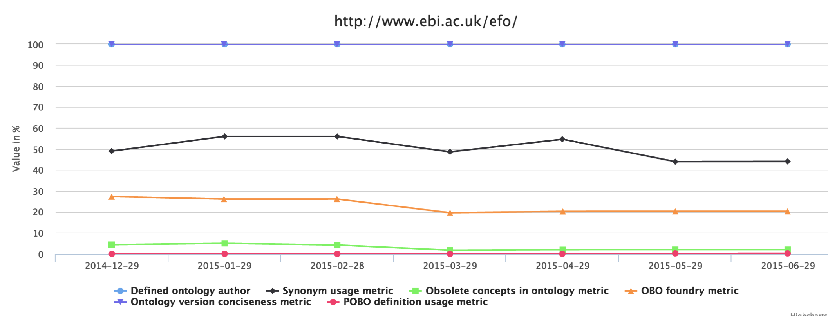
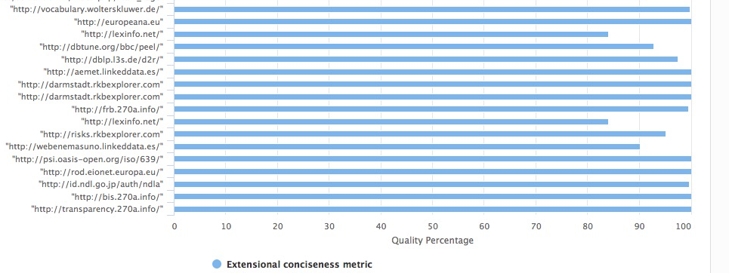
Quality Metadata in Action
Comparing Datasets over a Metric
Dataset’s Quality over Time
Filtering and Ranking
Notes:
daq metadata can be used in various ways.
For example, Users can filter datasets using faceted navigation to rank datasets based on different quality aspects.
Users can also place different weight on different granularity aspects of quality, that is either a weight on a category, a dimension, or a specific metric
daQ metadata can also be used for visualising quality information.
For example, one can visualise how different datasets compare against each other over a particular quality metric
or even check how a dataset’s quality evolved over time

Slide 46
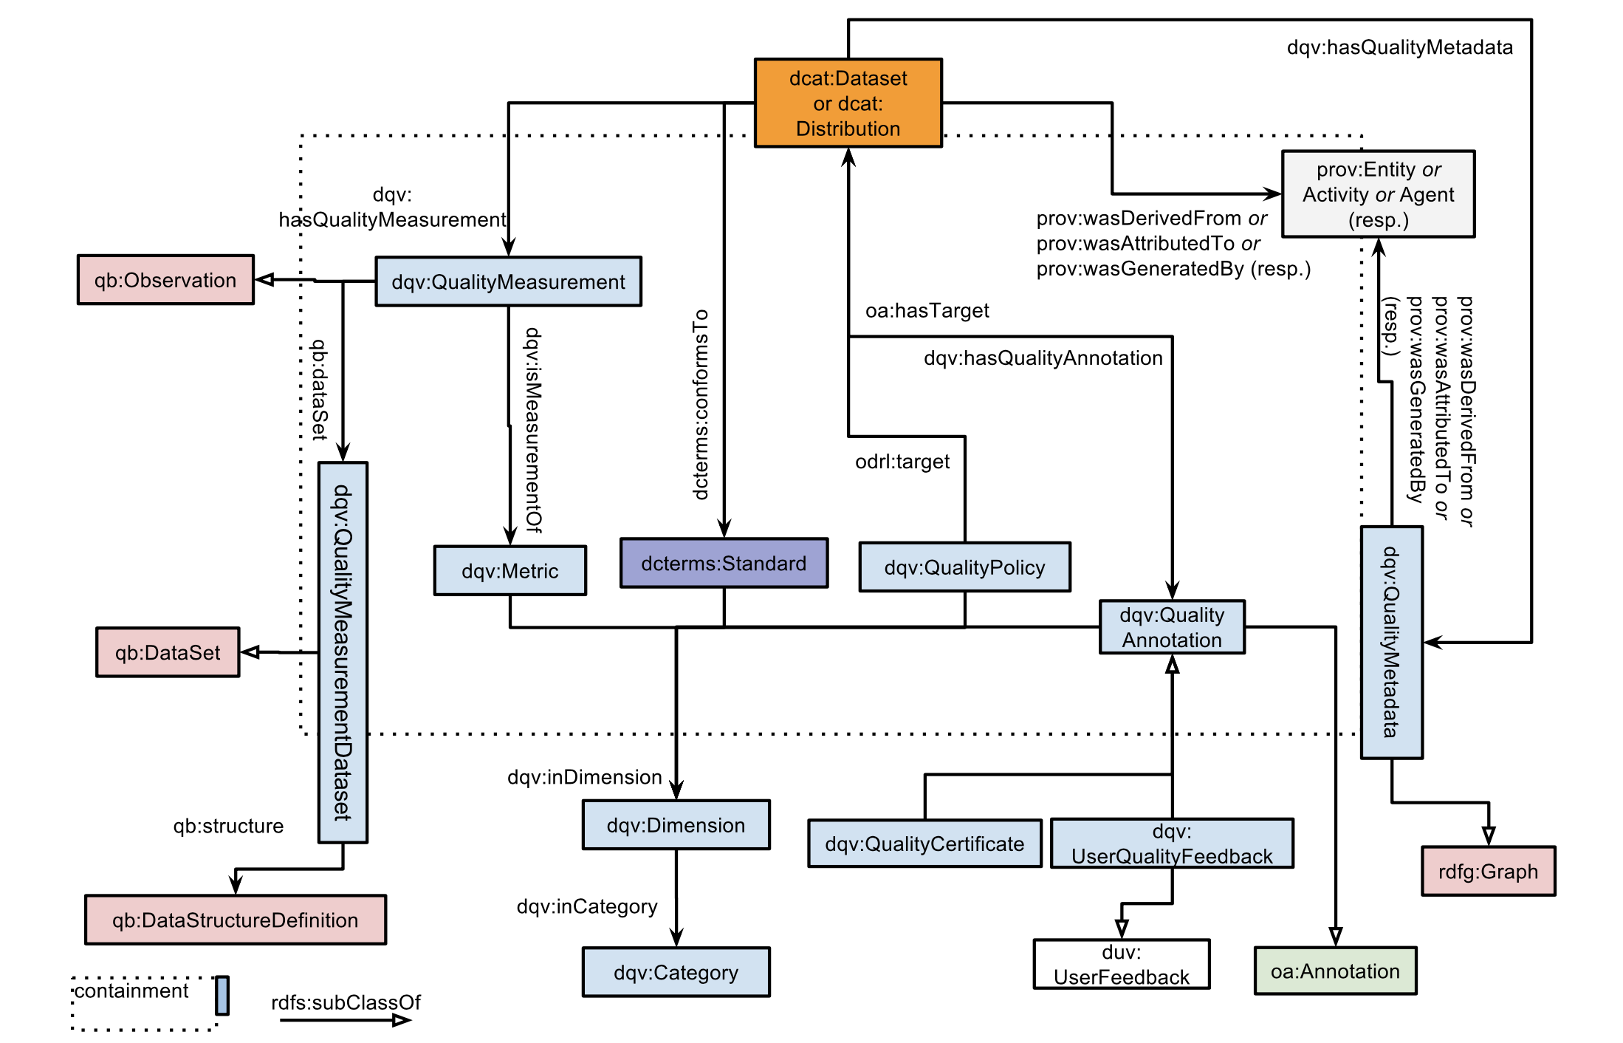
W3C Data Quality Vocabulary (DQV)
Policies: Express policies or agreements a dataset follows defined by some data quality concerns
Annotations: Providing rating, certificates, feedback etc…
Feedback: Comments from data consumers on a dataset (imagine comments in Trip Advisor)
Reasoner to transform from daQ to DQV and back
https://www.w3.org/TR/vocab-dqv/
Notes:
A W3C working group, data on the web best practices, have recently defined a data quality vocabulary
the idea is similar to the initial idea of daQ, allowing for quality measurements and values, however they take daQ a step further and put more emphasis on feedback, annotations, agreements and policies
The Quality Policy concept allows for the definition of agreements defined by data quality concerned for example that the dataset endpoint is at least 99% of the time available
The annotation concept in this vocabulary allows users to define, possibly existing quality certificates, irrelevant from the quality assessment performed and defined in the quality metadata
wrt feedback, the idea is that data consumers can provide comments, questions or classifications on a particular dataset or distribution, something similar to how users provide feedback for restaurants etc in tripadvisor
reasoner to transform daq to dqv and back

Slide 47
Lecture Overview
Conceptual Methodology for Assessing Data Quality
SoTA in Linked Data Quality Assessment
Assessing Large Linked Datasets
Representing Quality Metadata
Outlook towards the Quality of the Web of Data
Assessing Ontology Quality
Conclusions
Notes:
Having discussed quality assessment frameworks, quality metrics, and data quality vocabularies, we will now discuss how the web of data fares wrt its quality

Slide 48
Quality of the Web of Data
What is your opinion on the Quality of the Web of Data?
Notes:
So from experience, what is your opinion on the quality of the web of data?

Slide 49
Assessing the quality of the Web of Data
Quality Assessment for 130 Linked Datasets
≈ 3.7 billion triples assessed
27 Quality Metrics, 4 categories
J. Debattista, C. Lange, S. Auer. Evaluating the Quality of the LOD Cloud. Under Review at the Semantic Web Journal
Notes:
we assessed 130 datasets over 27 quality metrics from the 4 different categories discussed earlier on
This resulted into into around 3.7 billion triples being assessed by luzzu and the implemented metrics
For the methodology please read the mentioned paper

Slide 50
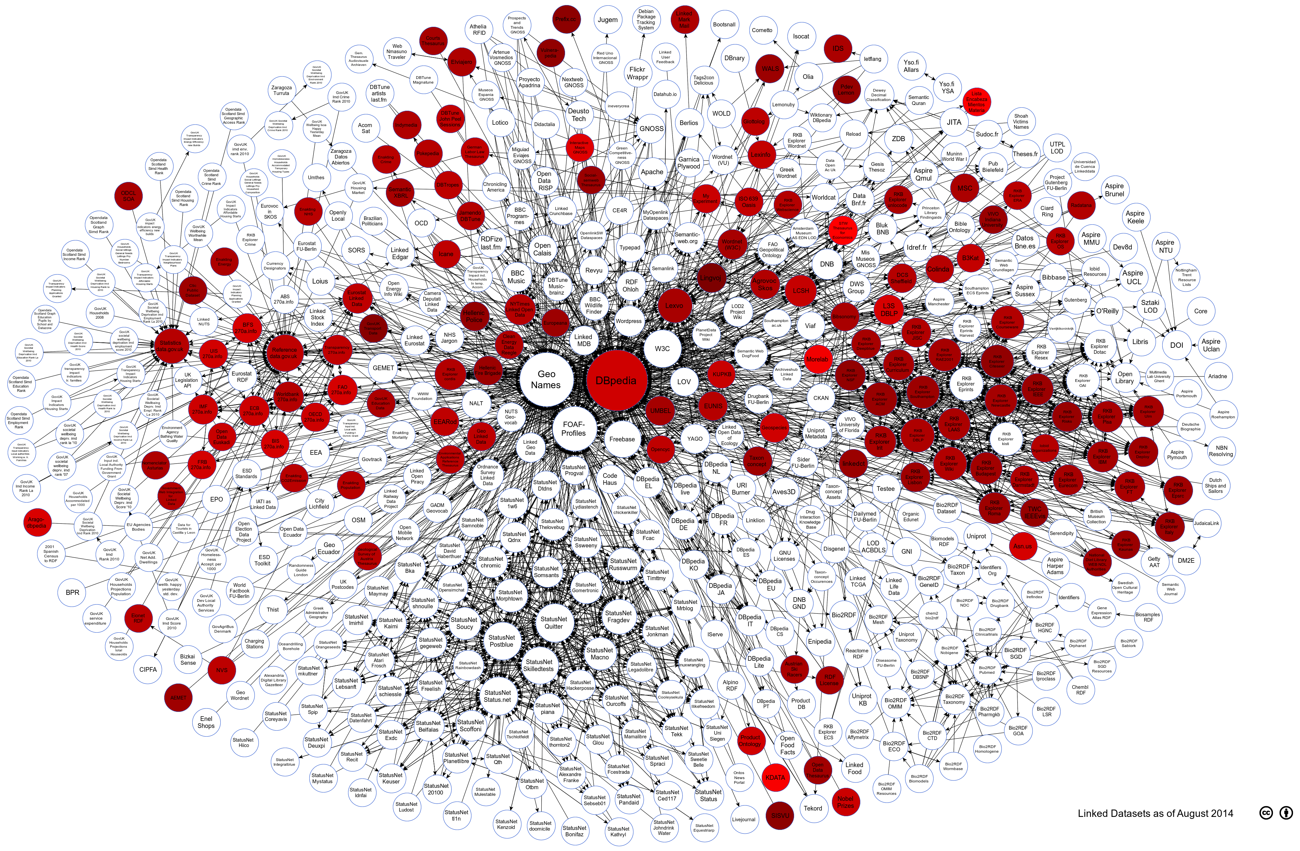
Web of Data Quality - Aggregated
Dataset (http://) | Aggregated Quality Score | Pos
zbw.eu | 84.72% | 1st
id.sgcb.mcu.es | 83.91% | 2nd
kdata.kr | 82.22% | 3rd
morelab.deusto.es | 80.12% | 4th
mapasinteractivos.didactalia.net | 74.18% | 5th
...
citeseer.rkbexplorer.com | 48.31% | 126th
prefix.cc | 46.64% | 127th
kent.zpr.fer.hr | 46.61% | 128th
transport.data.gov.uk | 45.09% | 129th
lingvoj.org | 41.41% | 130th
Notes:
on the whole, average conformance score stood around 60% with a slight deviation of 7%. This suggest that overall publishers seem to have more-or-less similar understanding of different quality issues.
The darker the color of the circle means that it has lower conformance score.
we can also see the top 5 and bottom 5 datasets. Can you recognise some of them?
Lets take a look at the different categories individually :

Slide 51
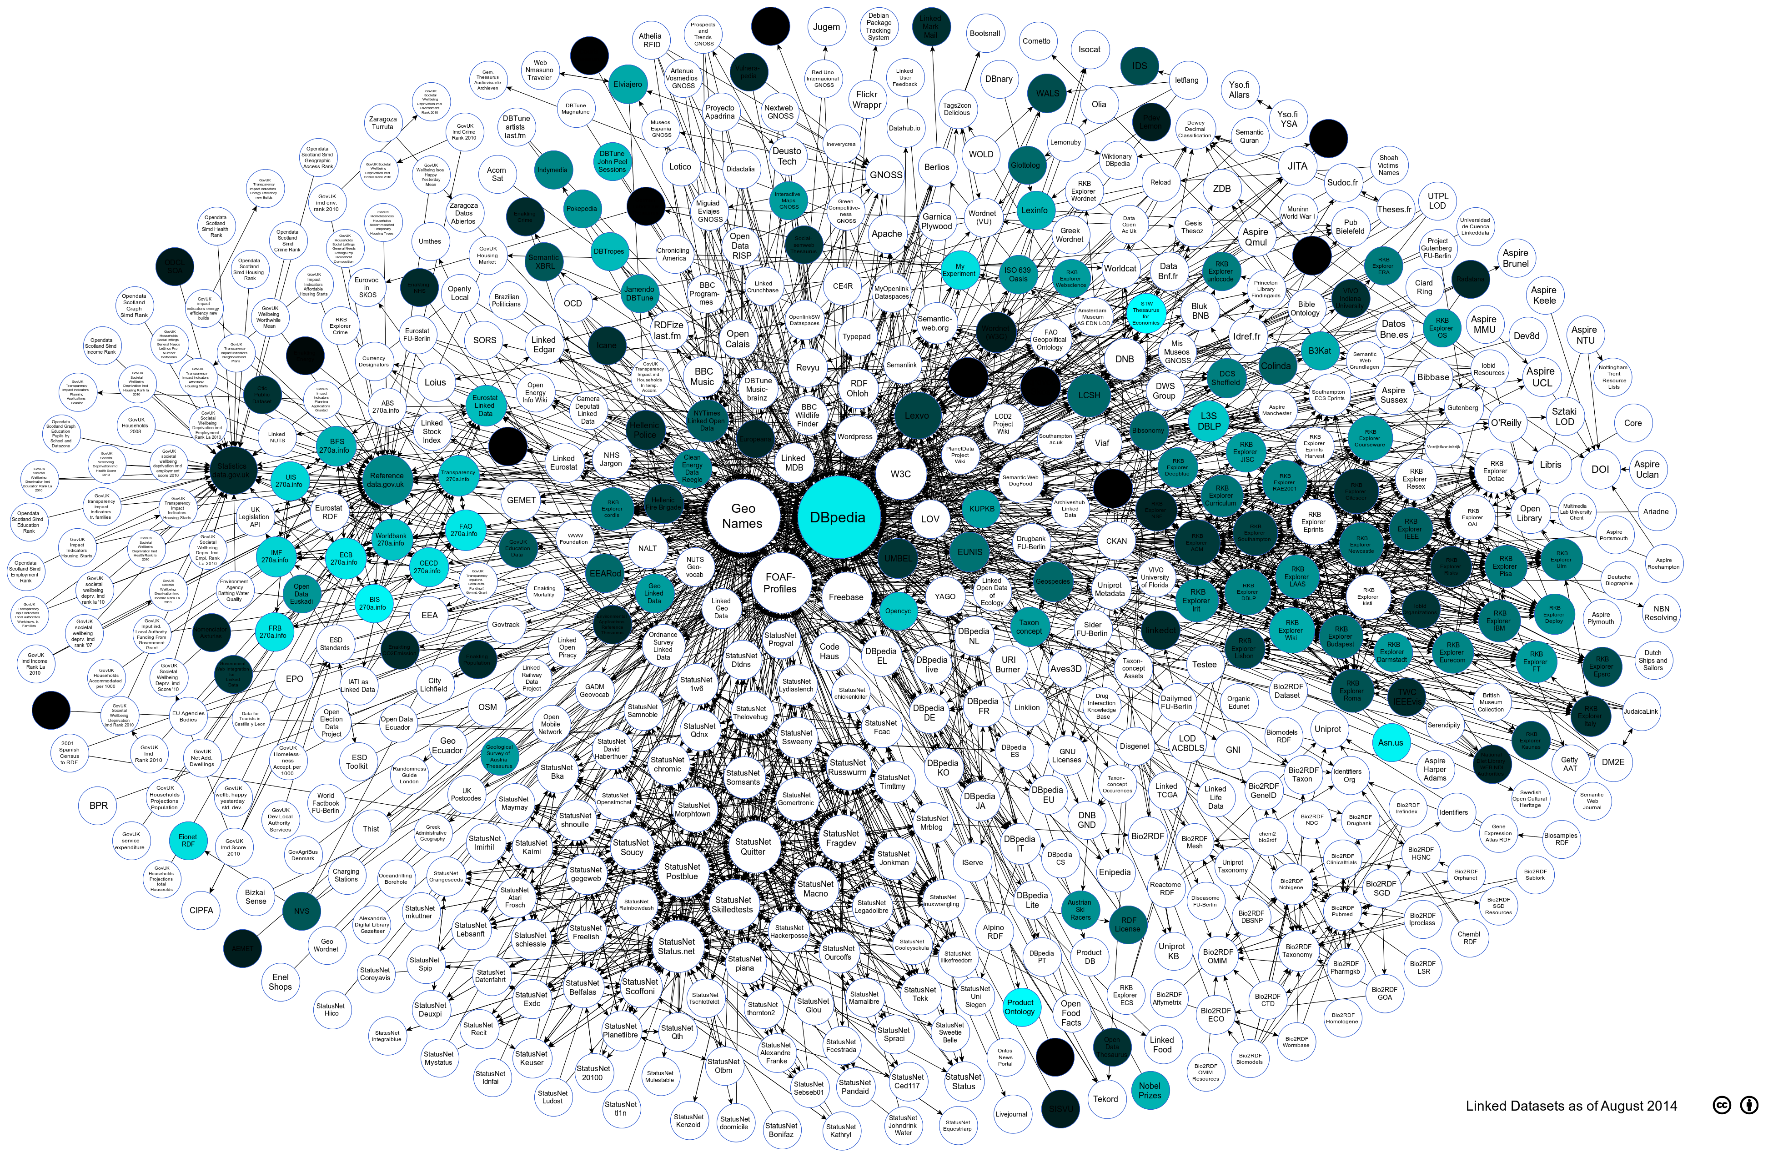
Web of Data Quality – Accessibility Category
Accessibility Category:
Examples: Availability of Resources, Licensing, Server Performance
Lessons Learned:
Average Conformance: 30%
Standard Deviation: 19%
Low usage of Machine-Readable Licences (17 out of 131 datasets) and Human-Readable Licences (11 out of 131 datasets)
Notes:
Starting with the accesibility category we can see that datasets like dbpedia has a high conformance amongst the other assessed datasets
the assessment identified that a large concentration of low quality values were mostly affected by licensing representation in the data itself

Slide 52
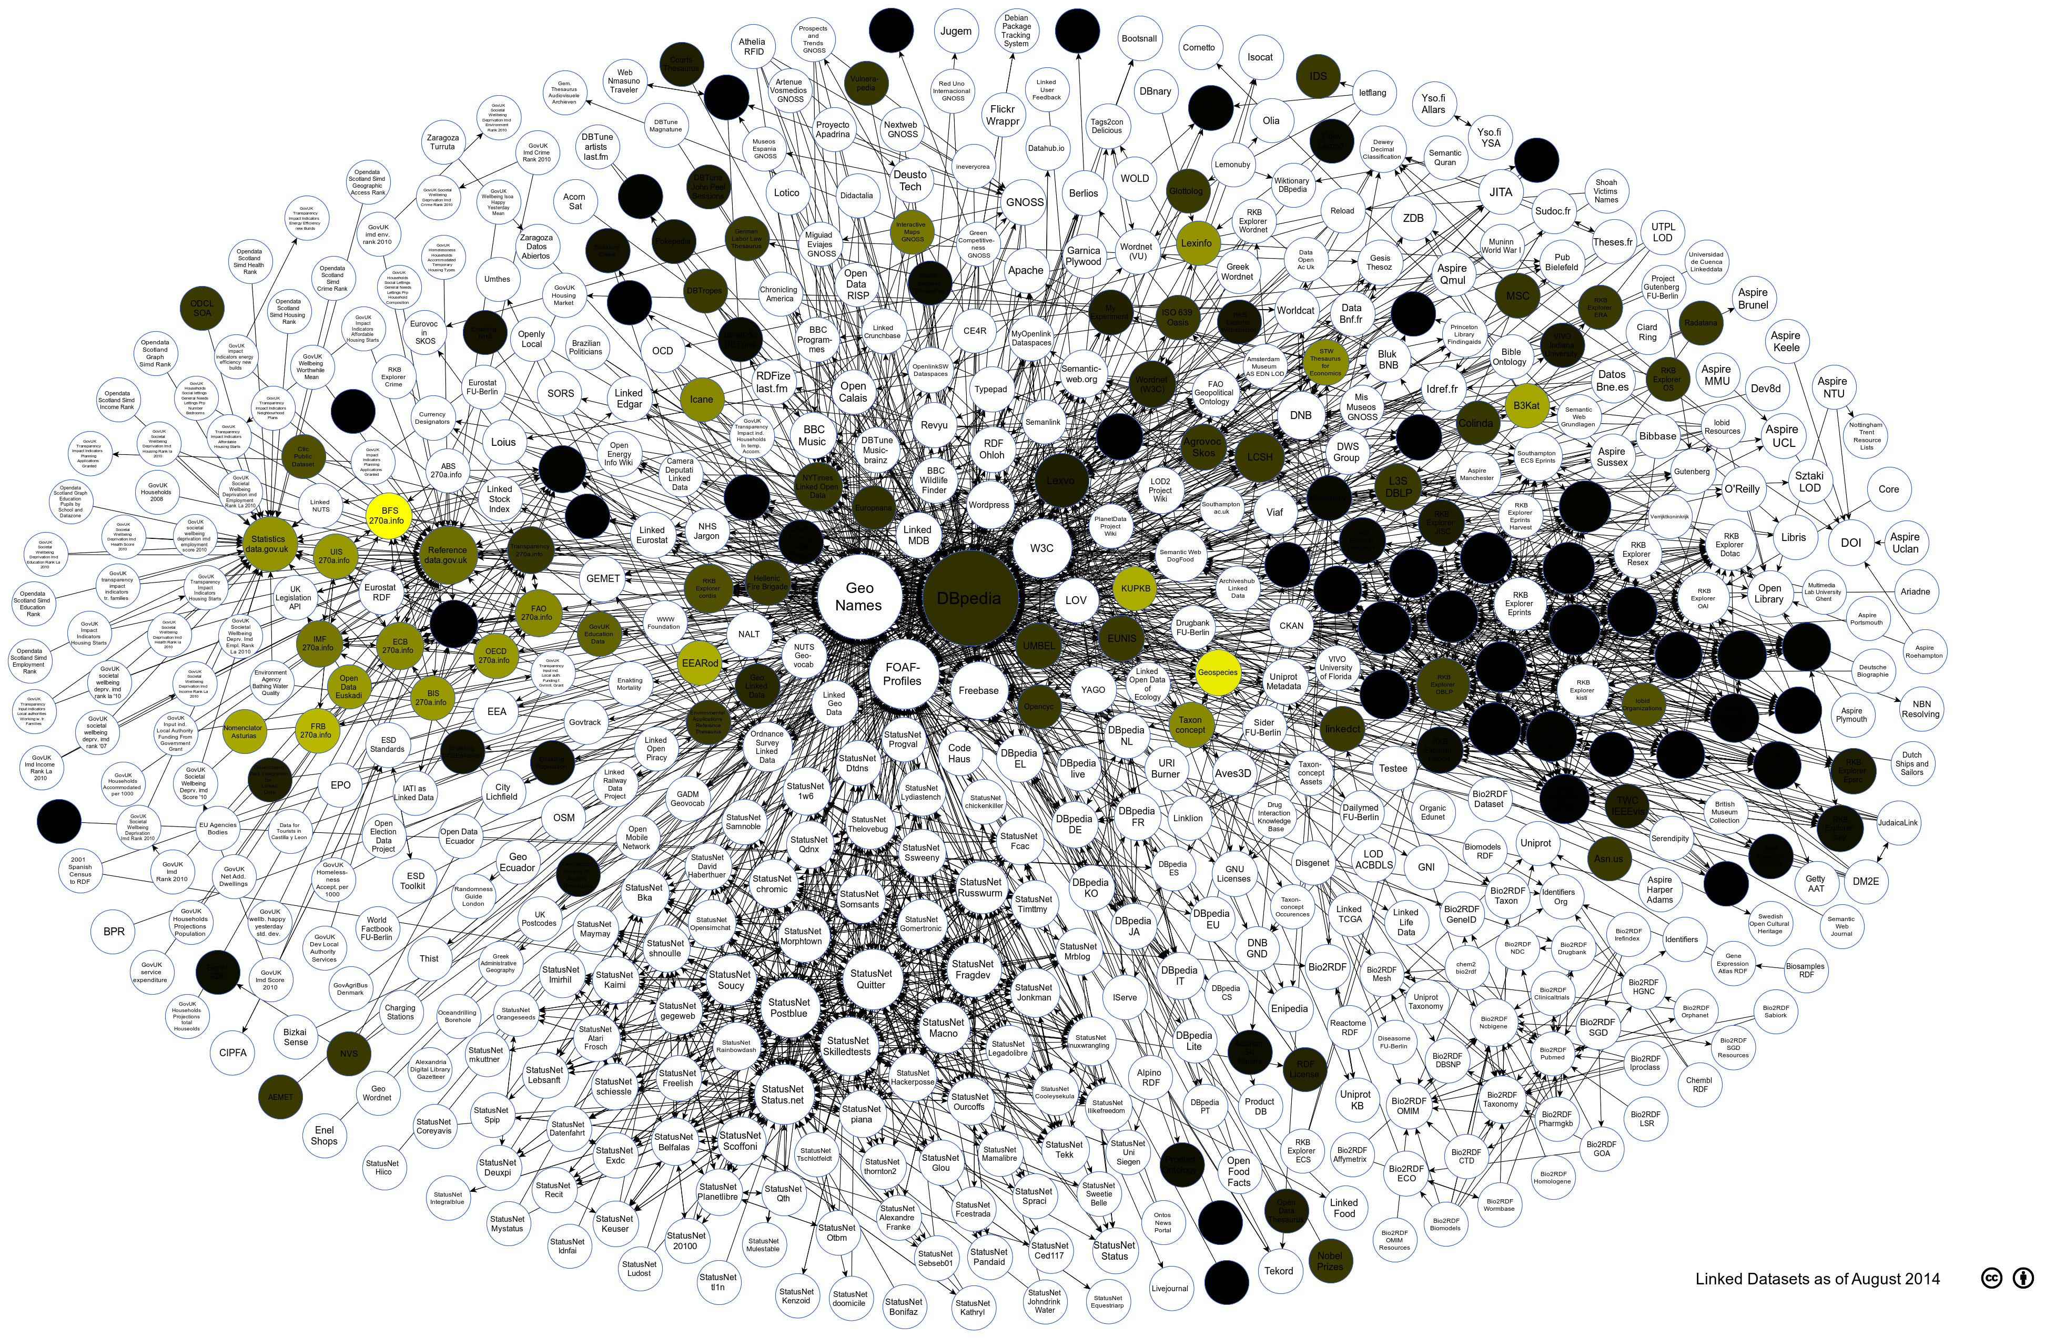
Web of Data Quality – Contextual Category
Contextual Category:
Examples: Provenance of Data, Human Comprehensibility
Lessons Learned:
Average Conformance: 13%
Standard Deviation: 13%
Poor conformance w.r.t. basic provenance information (e.g. creator of dataset), and traceability of data (predicates defining origin of data)
More effort towards human labelling and description of resources by publishers
Notes:
for the contextual category we found an overall poor quality amongst the metrics, however the most worrying is the fact that provenance information not given importance in the data itself.
similar to other studies, we also found out that data publishers have to strive harder to ensure better human readable labelling and descriptions.

Slide 53
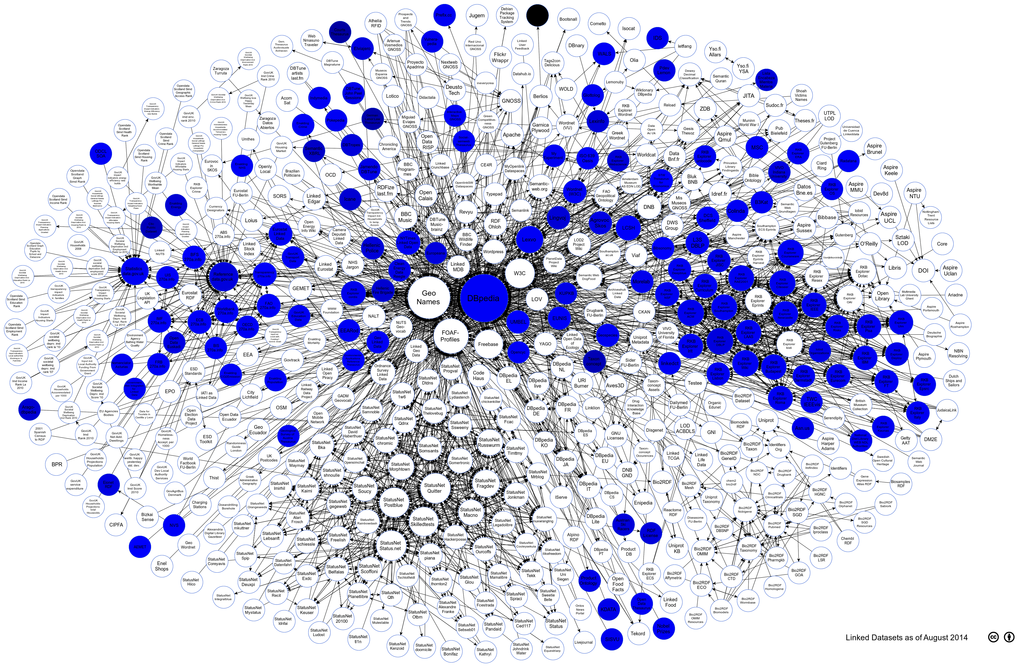
Web of Data Quality – Intrinsic Category
Intrinsic Category:
Examples: Syntactic Validity, Consistency, Conciseness
Lessons Learned:
Average Conformance: 77%
Standard Deviation: 13%
Overall high conformance for almost all metrics
Conformance towards the usage of correct domain or range datatypes should be improved (average conformance ≈ 60%)
Notes:
On the other hand, publishers tend to conform to quality issues related to the intrinsic category and this is shown with the high quality value and its moderate distribution, however data publishers should be more careful with using the right datatyped resources in the domain and range of a property.

Slide 54
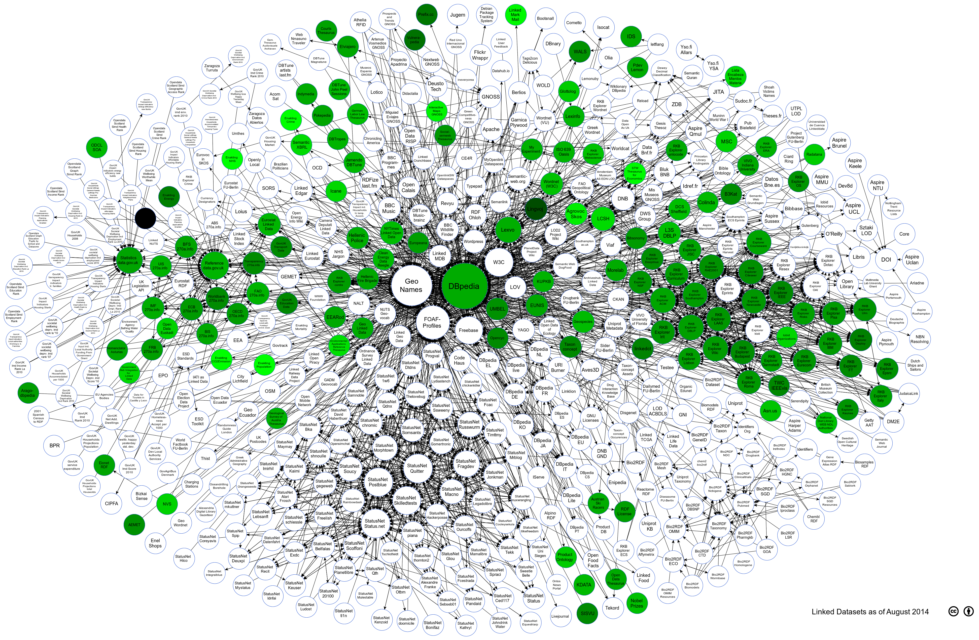
Web of Data Quality – Representational Category
Representational Category:
Examples: Interoperability, Versatility, Interpretability, Data Representation
Lessons Learned:
Average Conformance: 63%
Standard Deviation: 14%
Data publishers should re-use more existing terms (average conformance ≈ 34%)
Notes:
Finally, the representational category was similar to the previously mentioned category with results showing sufficient good quality and a moderate distribution.
However, in this case, data publishers should make sure to follow LD principles and were possible re-use existing terms by looking for schemas and ontologies in services such as linked open vocabularies or swoogle

Slide 55
Lecture Overview
Conceptual Methodology for Assessing Data Quality
SoTA in Linked Data Quality Assessment
Assessing Large Linked Datasets
Representing Quality Metadata
Outlook towards the Quality of the Web of Data
Assessing Ontology Quality
Conclusions
Notes:
We talked in detail about data quality, now I will give you a very brief overview on some work we are doing on ontology quality.
I will furthermore explain how we developed a pipeline to connect two semantic-based tools, luzzu and webvowl together to use during ontology quality.

Slide 56
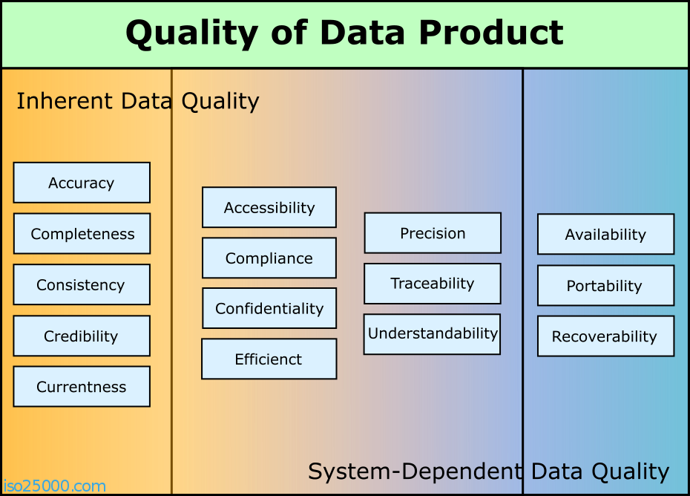
ISO/IEC 25012 Standard
  Every metric identified in the research was mapped to the ISO/IEC 25012 Model:
    The Inherent Category – measures intrinsic quality characteristics.
    The System Category – measures the degree of quality when the system is used.
    The Inherent-System Category – which includes metrics covering both aspects.
S. McGurk, J. Debattista, C. Abela. Towards Ontology Quality Assessment. 4th Workshop on Linked Data Quality (LDQ)
Notes:
We performed an initial survey on quality metrics for schemas. The search included also quality metrics that are used in software engineering, databases etc..
Identified metrics were mapped to the ISO/IEC 25012 Model, depending on the category and dimension to which it belongs.
The ISO/IEC 25012 is an approved standard, forming part of a series of International Standards for Software Product Quality Requirements and Evaluation (SQuaRE).
The ISO standard has three categories:
The Inherent Category – which caters for metrics that measure the degree to which the model itself has quality characteristics of intrinsic nature to satisfy `fitness for use'.
The System Category – which refers to quality metrics that measure the degree to which quality is maintained when the system is under specific use.
The Inherent-System Category – which includes metrics that look and measure both inherent and system aspects.
I won’t go into the different metrics, however, more information can be found in the listed paper

Slide 57
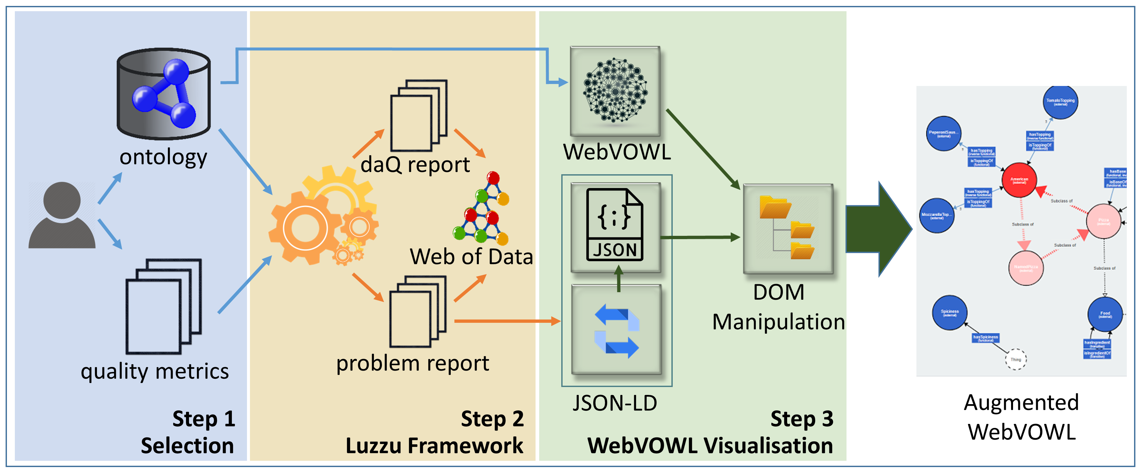
OntoQAV: Visualising Ontology Quality Problems
S. McGurk, J. Debattista, C. Abela. OntoQAV: Visualising Ontology Quality. Under Review (ISWC Posters and Demo)
Notes:
WebVOWL is a well known tool that visualises ontologies in an easy-to-digest manner.
Leveraging on WebVOWLs potential and Luzzu’s semantically interoperably quality reports, a student of mine designed a pipeline that connects the two tools in an attempt to provide an ecosystem whereby engineers can assess and interactively understand quality problems in concepts and properties, and in turn help them find fit for use schemas.
The idea is that first luzzu assesses an ontology based on a set of quality metrics, the reports are then passed into webvowl for visualisation, which in turn creates an augmented visualisation highlighting the problematics classes and. properties

Slide 58
Evaluating the Pipeline
Can I have some volunteers to evaluate this system?
Notes:
We are currently performing some evaluation and we need some volunteers for a some tasks which would not take more than 30 mins. Can I find some volunteer?

Slide 59
Lecture Overview
Conceptual Methodology for Assessing Data Quality
SoTA in Linked Data Quality Assessment
Assessing Large Linked Datasets
Representing Quality Metadata
Outlook towards the Quality of the Web of Data
Assessing Ontology Quality
Conclusions
Notes:
Finally we are at the end of this lecture

Slide 60
Conclusion – Problem and Challenges
✓
Detecting data quality problems in different sized datasets;
Making information about data quality readily available for public consumption;
Identifying the right data quality indicators for the task at hand;
Continuously assessing data quality in dynamic datasets;
…
✓
✓
X
The Internet 2015 is licensed under a CC-BY-NC 4.0 © 2014 by LyonLabs, LLC and Barrett Lyon - http://www.opte.org/the-internet/
Notes:
so you remember these challenges right?
after this lecture you should be able to answer the first two challenges – using the different sota frameworks, metrics and the metadata vocabularies
the third challenge is also be somehow addressed however in a manual manner – data consumers can manual identify the right metrics for the task at hand
the fourth challenge is still unanswered and there is no solution for the time being with the current sota

Slide 61
Conclusions
SoTA evolved to meet the consumers need to characterise fitness for intended use
Don’t be afraid to push back time and apply algorithms and ideas to implement metrics maybe in a more scalable manner
Quality metadata vocabularies are available – if you are a publisher please use them
The quality of the Web of Data is not bad – but needs to improve
Do not re-invent the wheel – leverage the interoperability of semantic frameworks to achieve what you need (e.g. OntoQAV)
Notes:
So coming to my take home message

Slide 62
Scalable Linked Data Quality Assessment
Question Time!
jeremy.debattista@adaptcentre.ie
@jerdeb

Slide 63
References
J. Debattista, S. Auer, C. Lange. Luzzu - A Methodology and Framework for Linked Data Quality Assessment. In ACM Journal of Data Information Quality. V8 I1, November 2016
D. Kontokostas, P. Westphal, S. Auer, S. Hellmann, J. Lehmann, R. Cornelissen, A. Zaveri. Test-driven Evaluation of Linked Data Quality. In: Proceedings of the 23rd International Conference on World Wide Web. WWW ’14. Seoul, Korea: pp. 747–758. doi: 10.1145/2566486.2568002 .
J. Debattista, S. Londoño, C. Lange, S. Auer. Quality Assessment of Linked Datasets using Probabilistic Approximation. In 12th European Semantic Web Conference Proceedings 2015, 221-236, Springer
J. Debattista. Scalable Quality Assessment of Linked Data. (Thesis) Universitäts-und Landesbibliothek Bonn 2017
A. J. Zaveri, A. Rula, A. Maurino, R. Pietrobon, J. Lehmann, and S. Auer. Quality Assessment for Linked Data: A survey. Semantic Web Journal, 2015
J. Debattista, C. Lange, S. Auer. Representing dataset quality metadata using multi-dimensional views. In Proceedings of the 10th International Conference on Semantic Systems (SEMANTiCS ’14), 92-99, ACM
S. McGurk, J. Debattista, C. Abela. Towards Ontology Quality Assessment. 4th Workshop on Linked Data Quality (LDQ)

Slide 64
About Me
Born and raised in Malta
Research Fellow at Trinity College Dublin in the ADAPT Centre
IRC Fellow
PhD at the University of Bonn / Enterprise Information Systems
  Linked Data Quality
@jerdeb
jeremy.debattista@adaptcentre.ie

Slide 65
SPARQL Examples on daQ
SELECT DISTINCT ?metric ?value {
?obs a daq:Observation ;
daq:metric ?metric_instance ;
daq:value ?value ;
sdmx-dimension:timePeriod ?dateTime
  FILTER NOT EXISTS {
  ?obs2 daq:metric ?metric_instance ;
  sdmx-dimension:timePeriod ?newerDateTime. FILTER (?newerDateTime > ?dateTime)
  }
?metric_instance a ?metric .
} ORDER BY ASC(?metric)
Get all observation for all metric instances.
Compare and filter instances to get the latest one.
Getting type of metric instance
Notes:
get latest observed value for a dataset

